Slide 1

Connecticut Vaccination Summary
Ridgefield COVID-19 Task Force
Data downloaded from
https://covid.cdc.gov/covid-data-tracker/#vaccinations
January 23, 2021

Slide 2
Connecticut Vaccination Summary
Saturday, 01/23/2021
Connecticut ranks #3 among states in percent of population receiving at least one dose.
Connecticut ranks #5 in administered doses as a percent of population.
Connecticut ranks #4 in distributed doses as percent of population.
Connecticut ranks #6 in administered doses as percent of distributed doses.
1
2
3
Conclusion: Connecticut ranks high in vaccines administered because it is doing an excellent job in administering doses that have been received from the Federal Government.
1
2
3
Shots Administered = Doses Received x Administration Efficiency
Driven By ------> Federal Government Local Governments

Slide 3
Connecticut and US Vaccination Summary

Slide 4
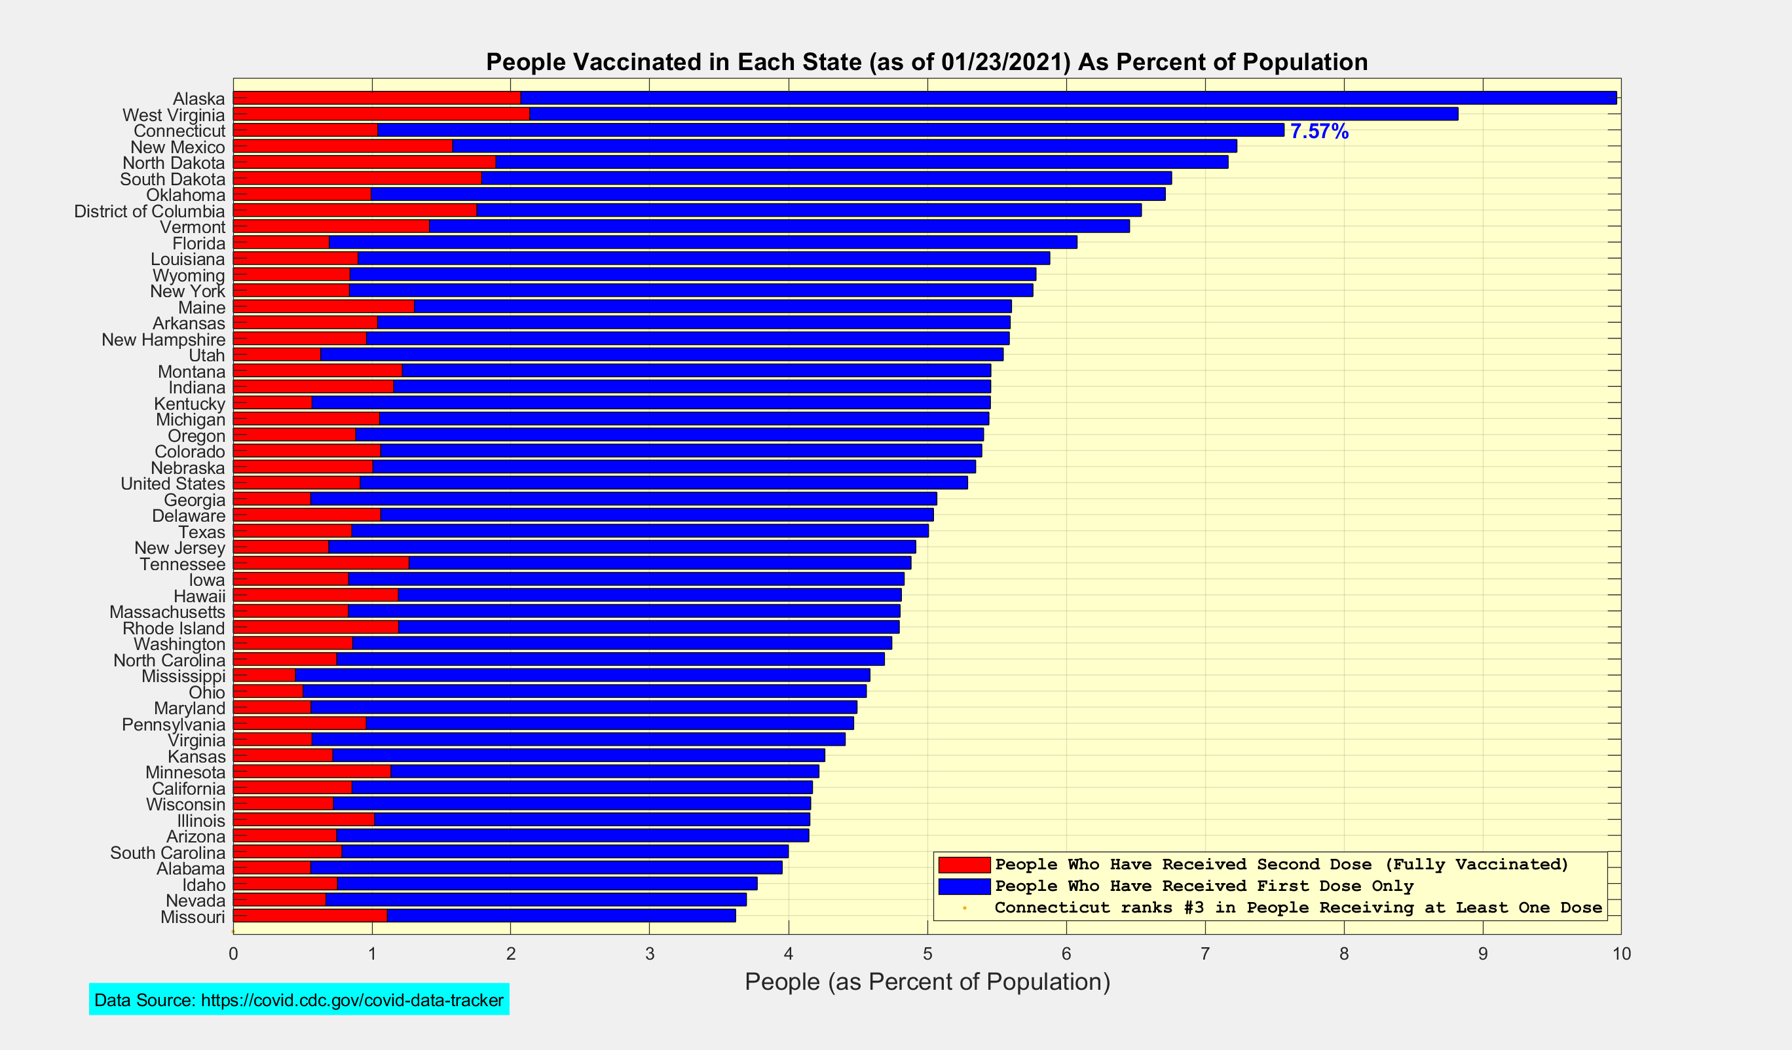
People Vaccinated in Each State as Percent of Population

Slide 5
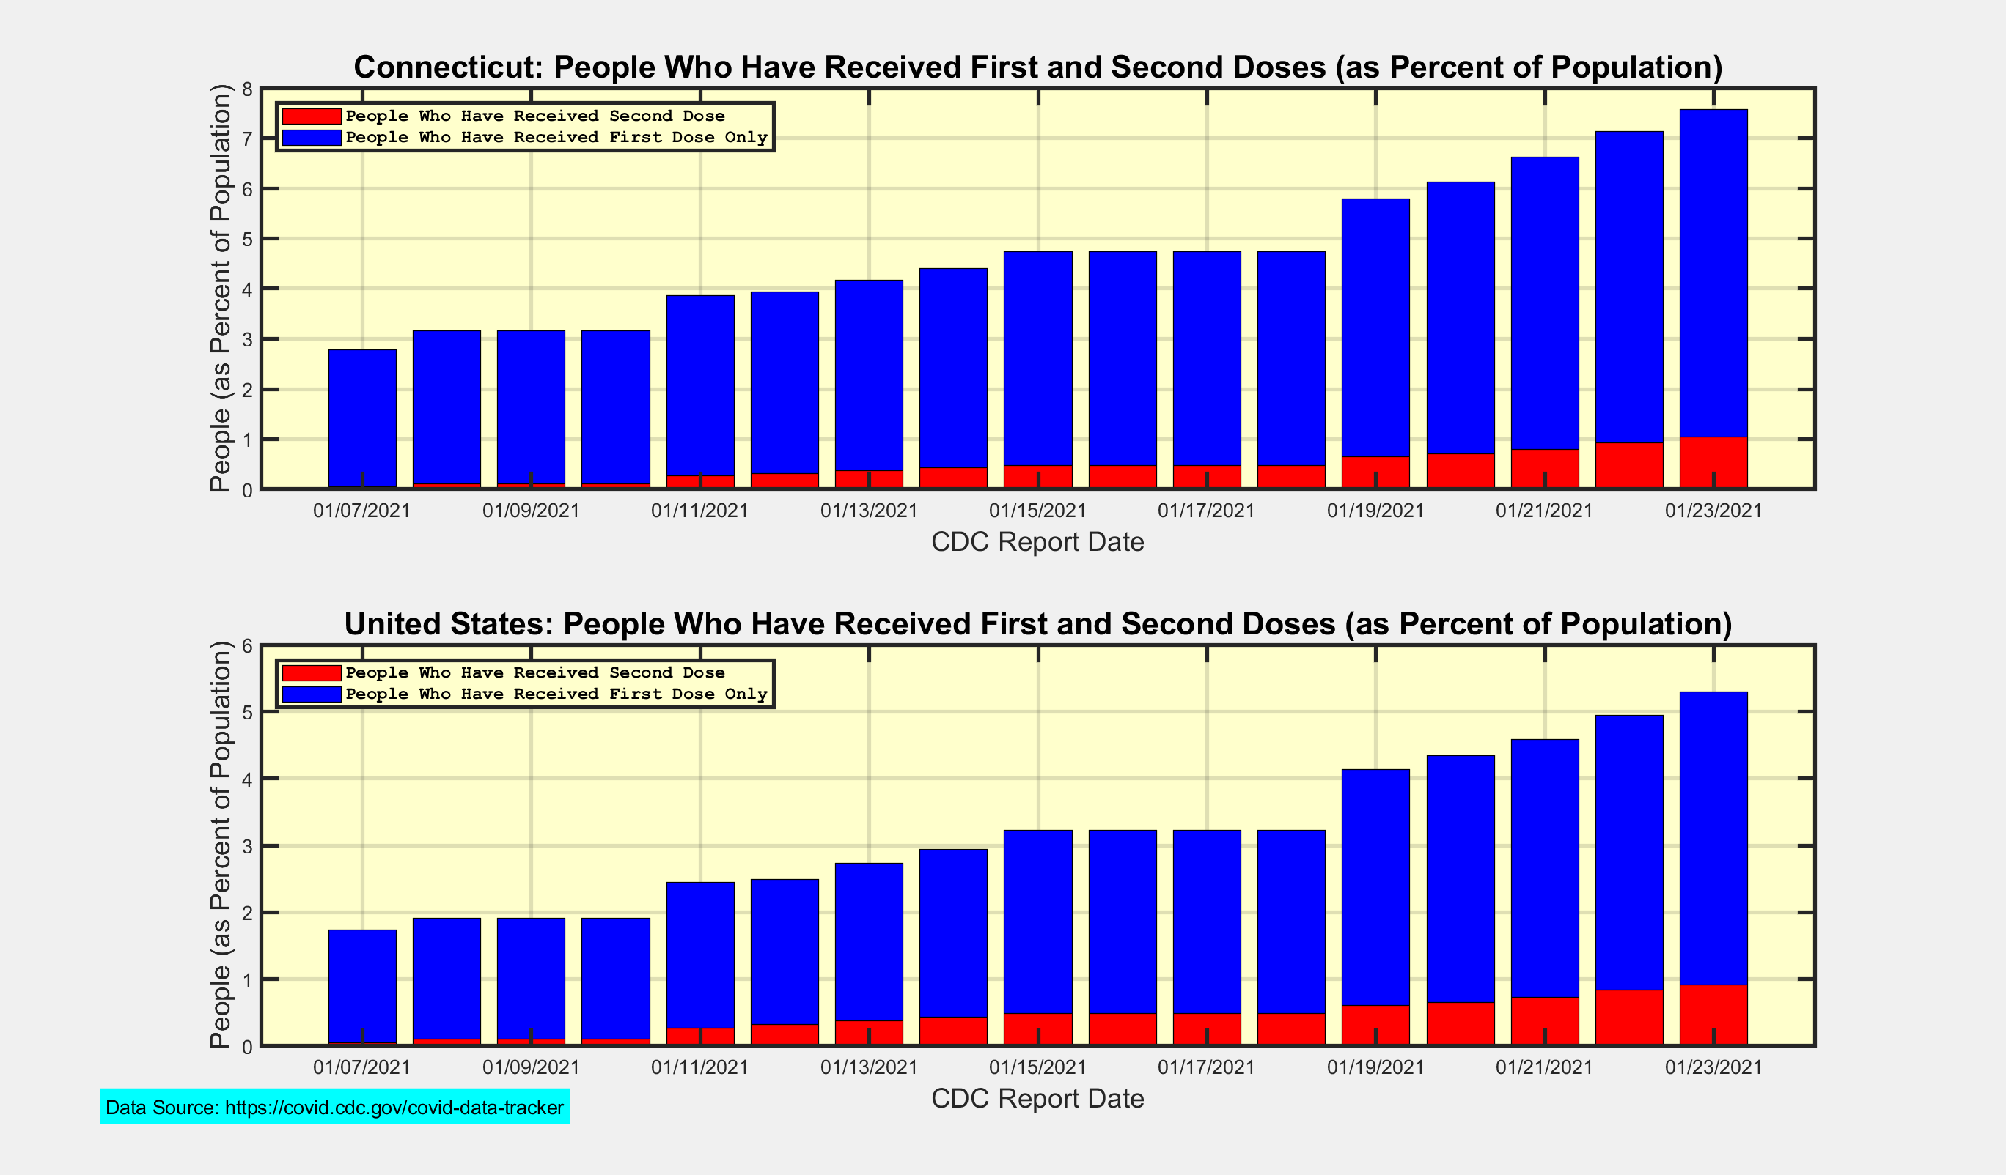
People who have received First and Second Doses

Slide 6
Introduction to Scatter Plot of Administered vs Distributed Doses
y-axis
x-axis
Red Diagonal Lines
Administered Doses = Distributed Doses x Administration Efficiency
The dashed lines can be thought of as ‘jet plumes’ showing the trajectory of each state since the previous CDC report.
Since the doses are cumulative, the dashed lines will always move upward and to the right.

Slide 7
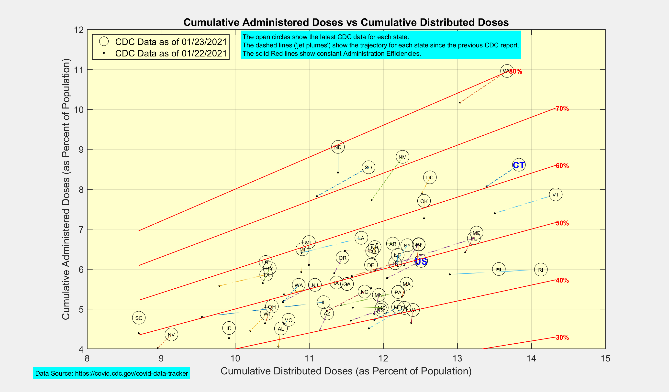
Scatter Plot: Administered vs Distributed Doses

