Slide 1

Ridgefield COVID Summary
Ridgefield COVID-19 Task Force
Data downloaded from
https://data.ct.gov/browse?category=Health+and+Human+Services
https://covid.cdc.gov/covid-data-tracker/#vaccinations
Wednesday, May 11, 2022

Slide 2
Ridgefield Summary

Slide 3
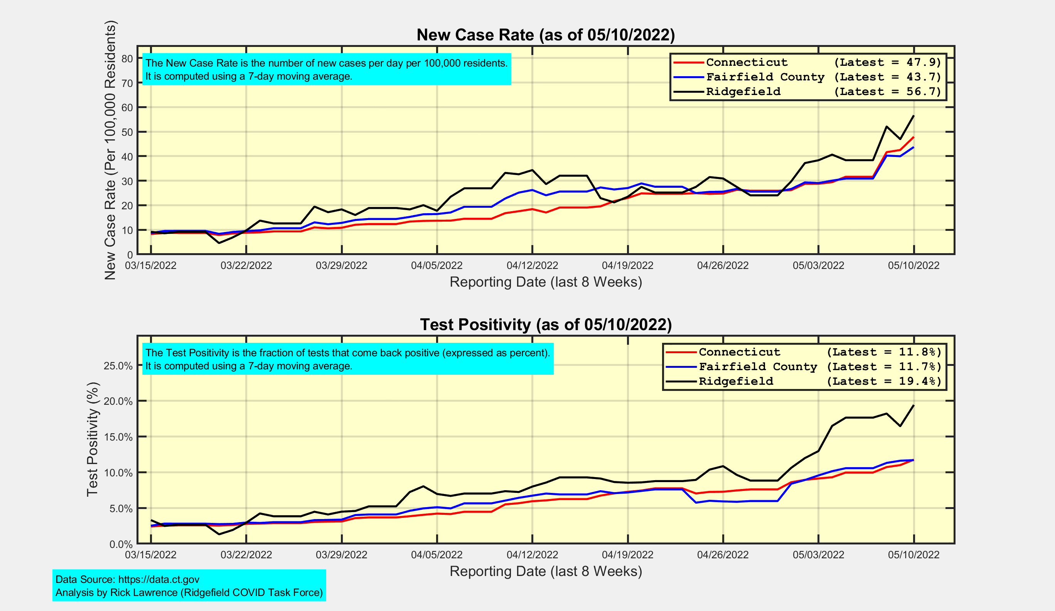
New Case Rates and Test Positivity for Connecticut, Fairfield County, and Ridgefield

Slide 4
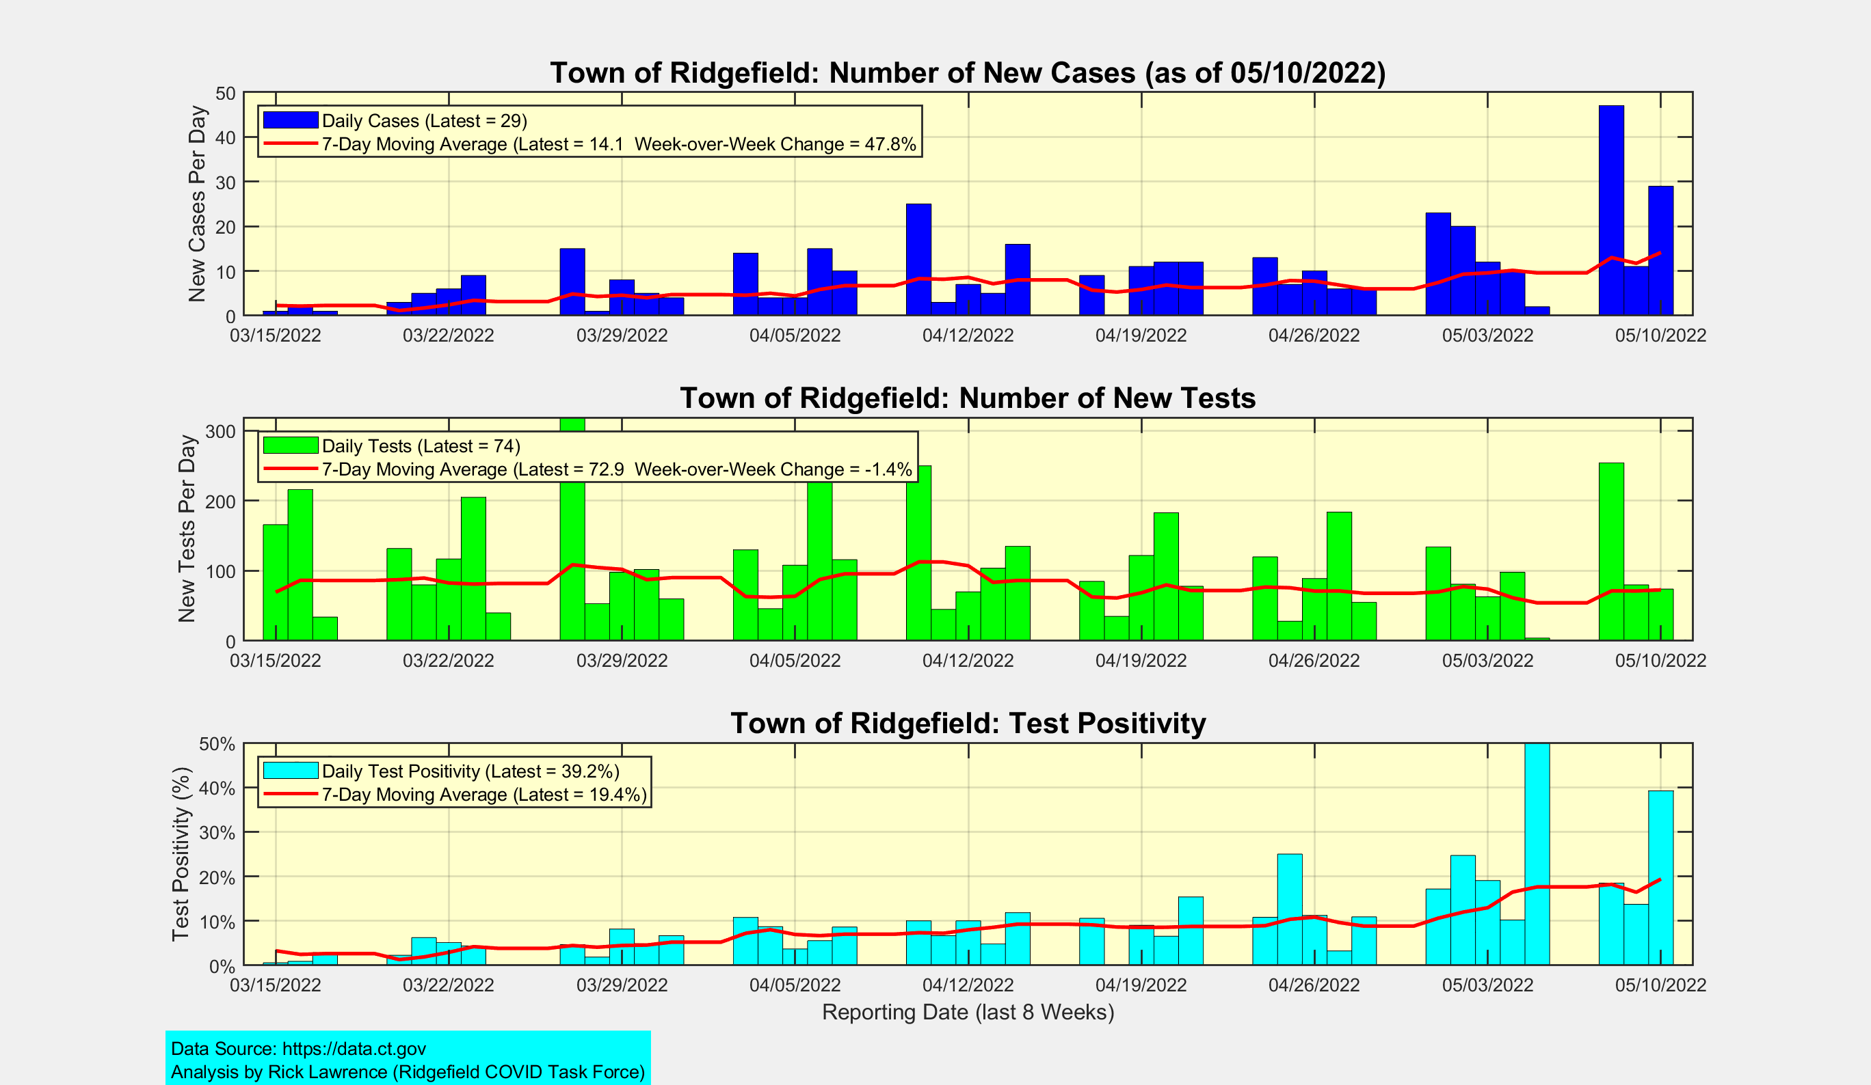
New Cases, New Tests, and Test Positivity for Ridgefield

Slide 5
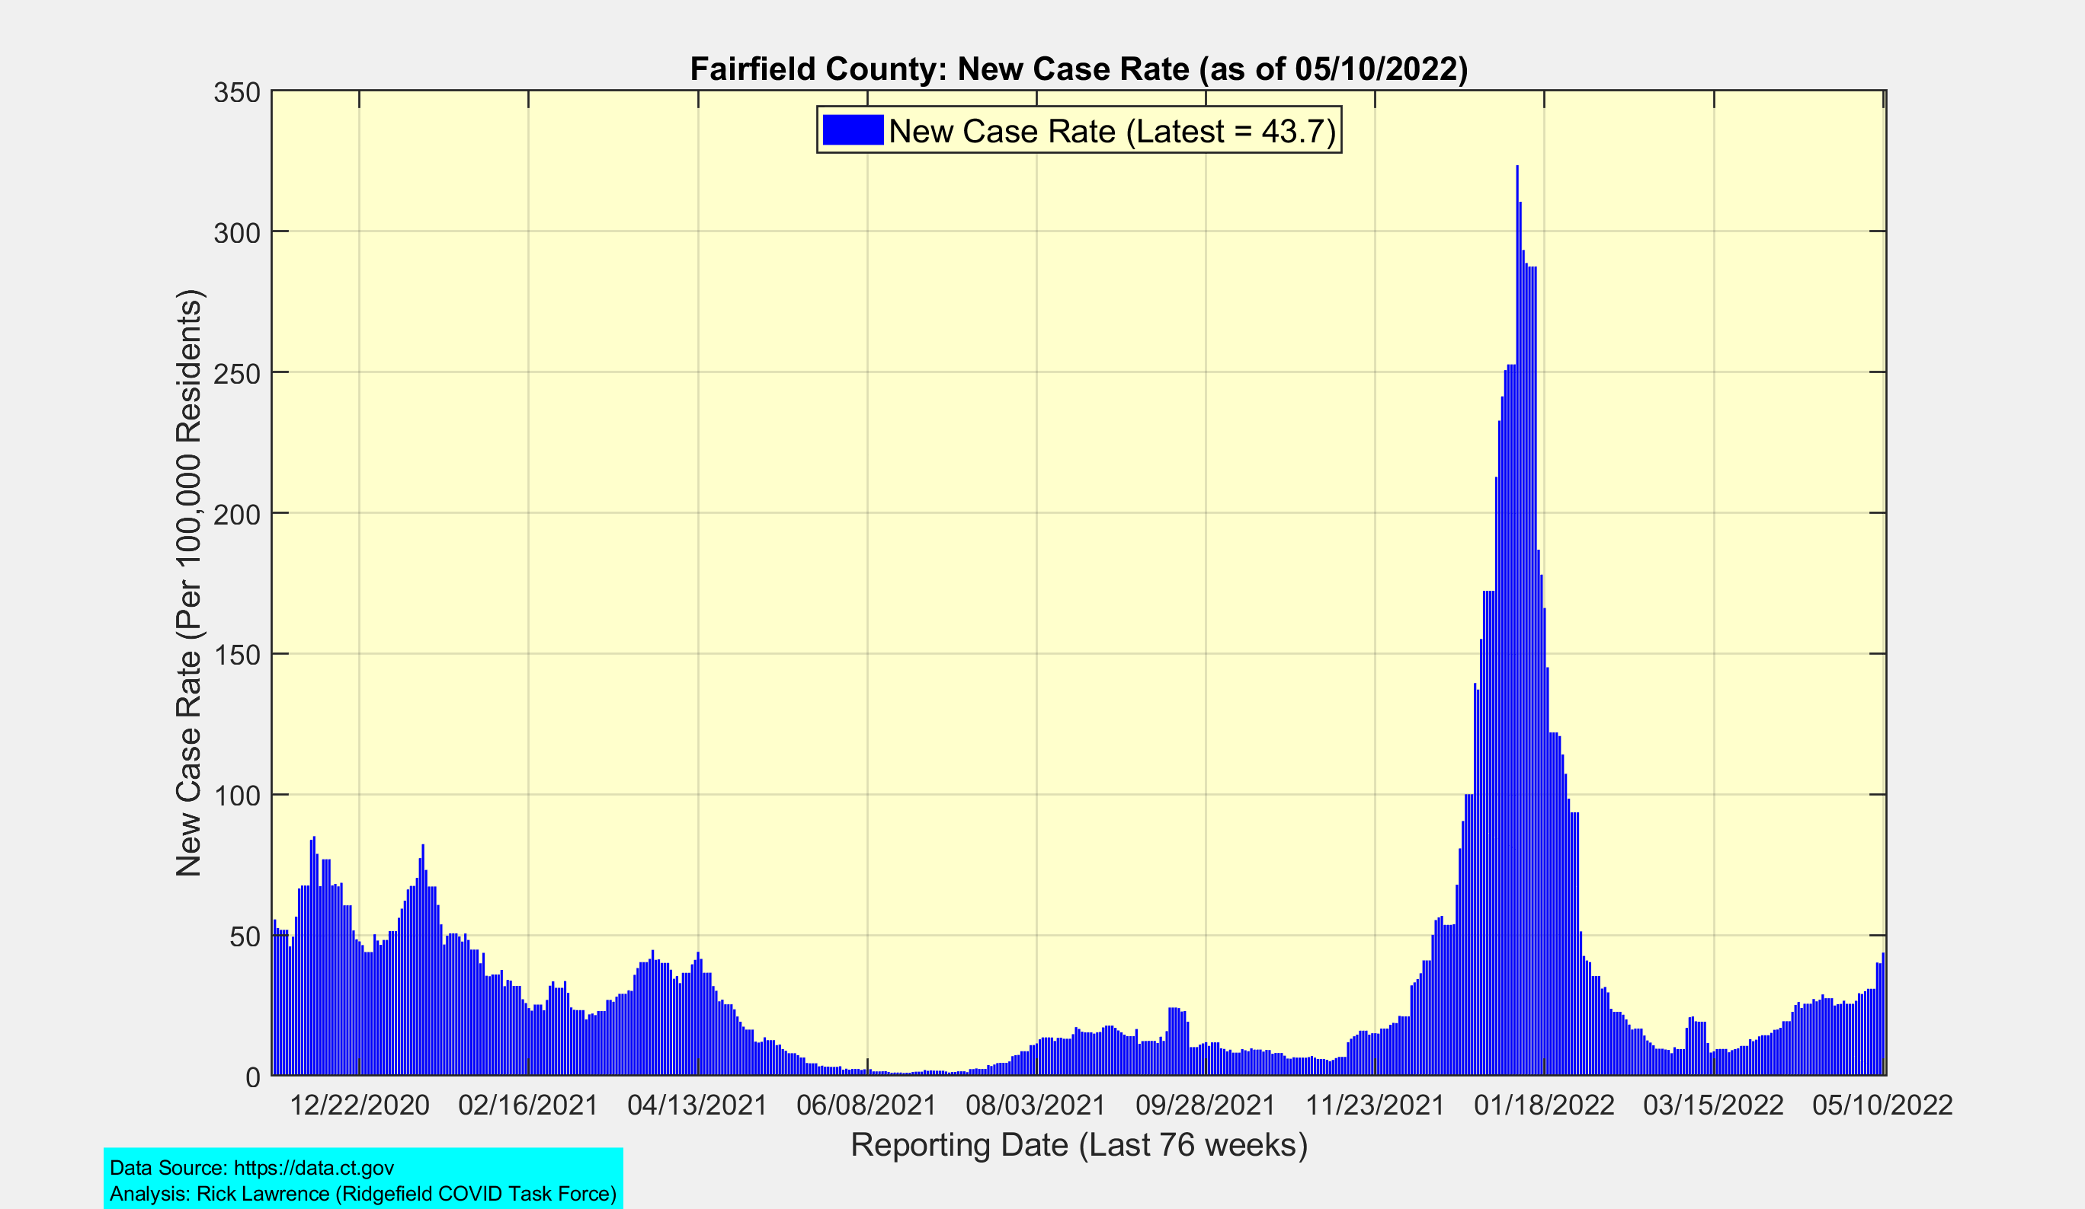
Fairfield County: New Case Rate
Omicron
BA.1
Peak
Winter
2020-21
Peak
Spring
2021
Peak
Omicron
BA.2
Delta
Peak

Slide 6
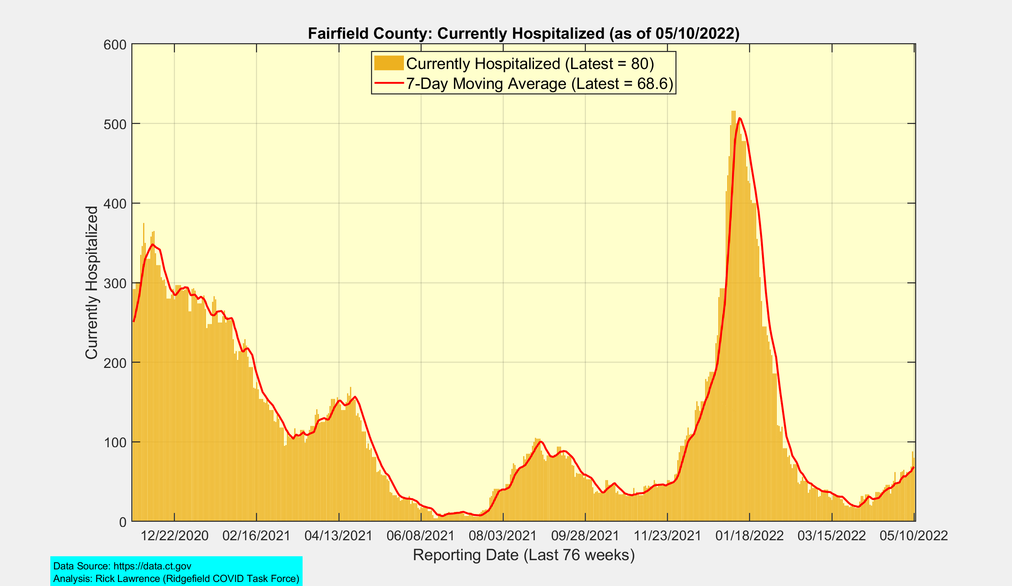
Fairfield County: Currently Hospitalized
Omicron
BA.1
Peak
Winter
2020-21
Peak
Spring
2021
Peak
Delta
Peak
Omicron
BA.2

Slide 7
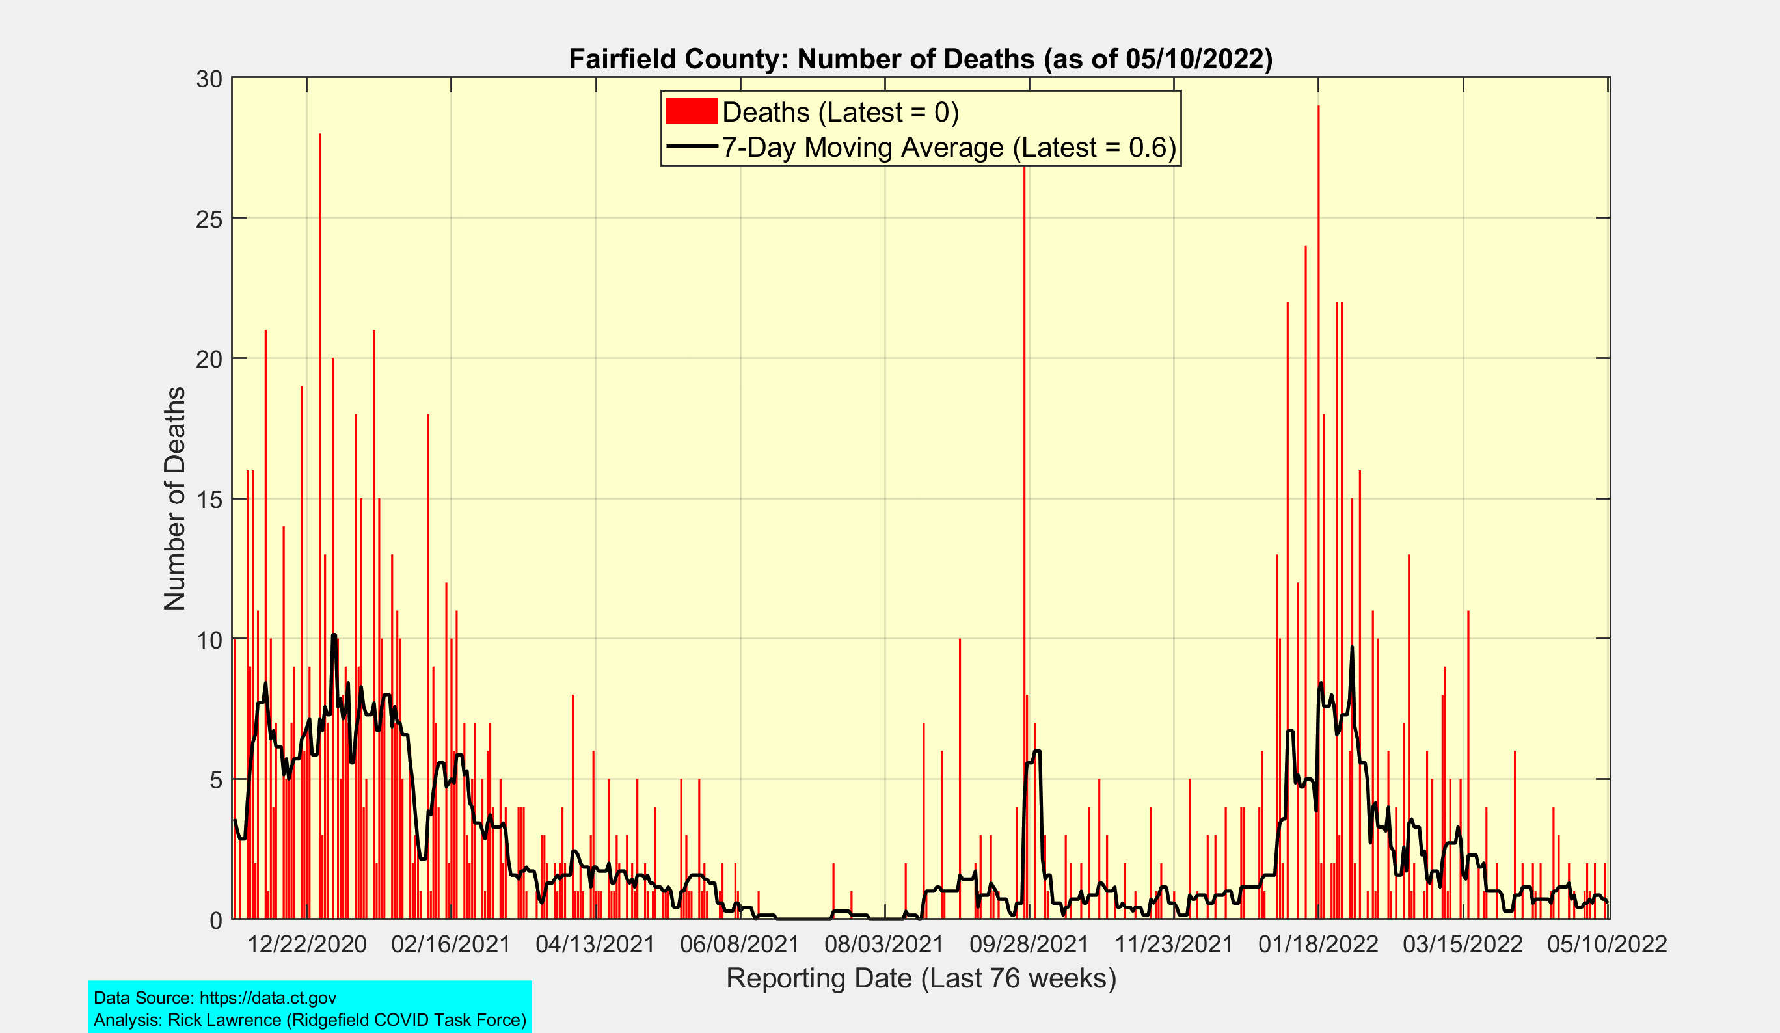
Fairfield County: Number of Deaths
Omicron
BA.1
Peak
Winter
2020-21
Peak
Delta
Peak
Spring
2021
Peak

Slide 8
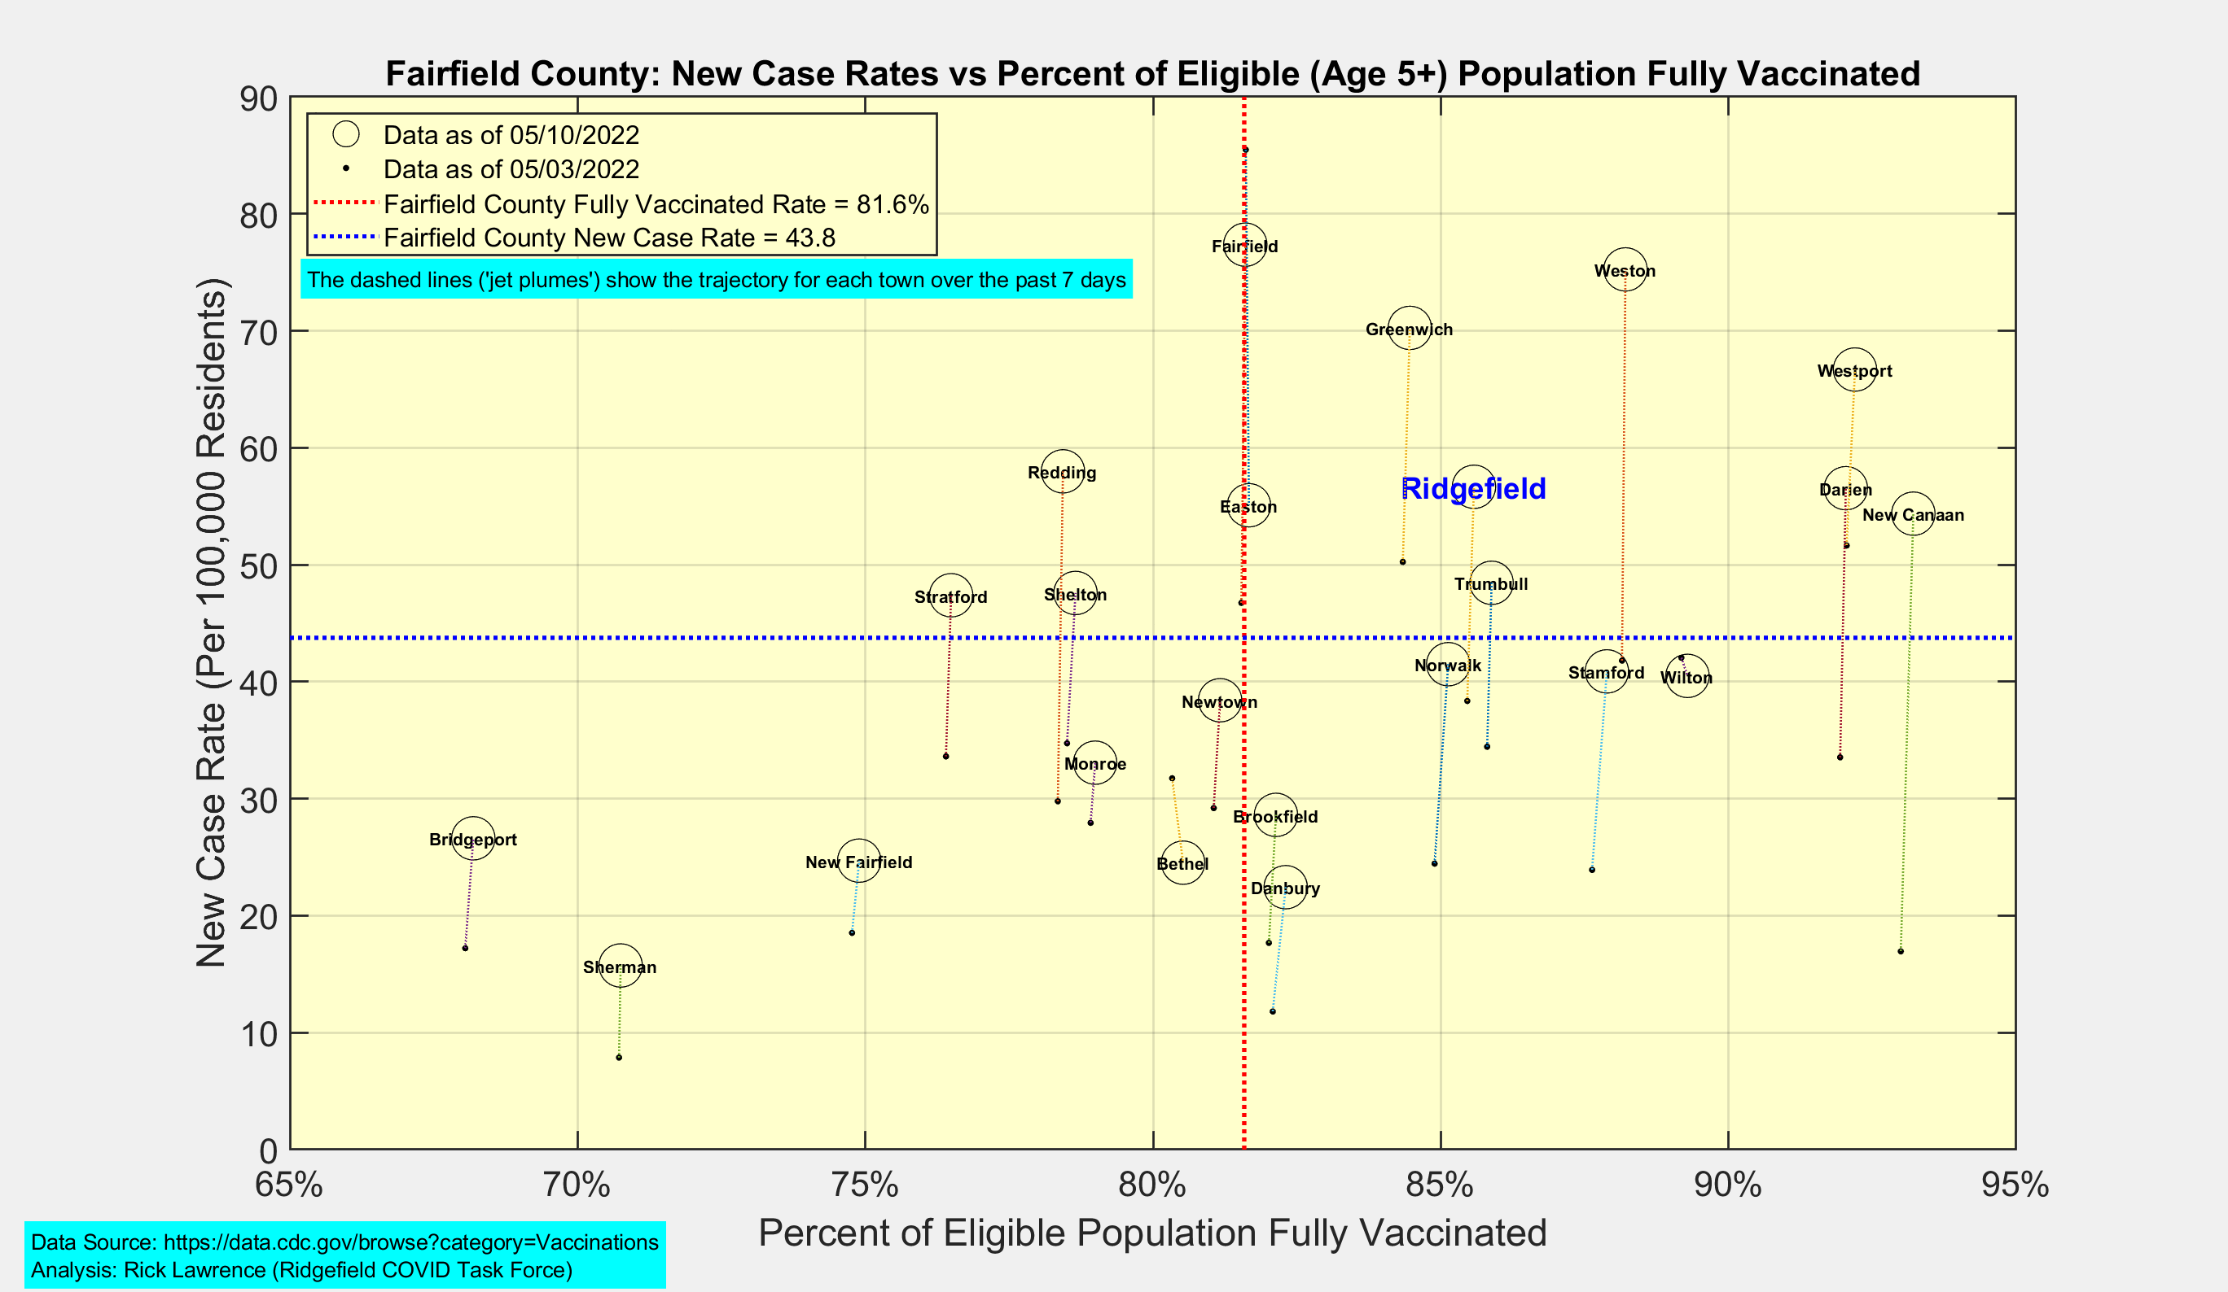
New Case Rates vs Vaccination Rates for Towns in Fairfield County

Slide 9
Connecticut and US Vaccination Summary

Slide 10
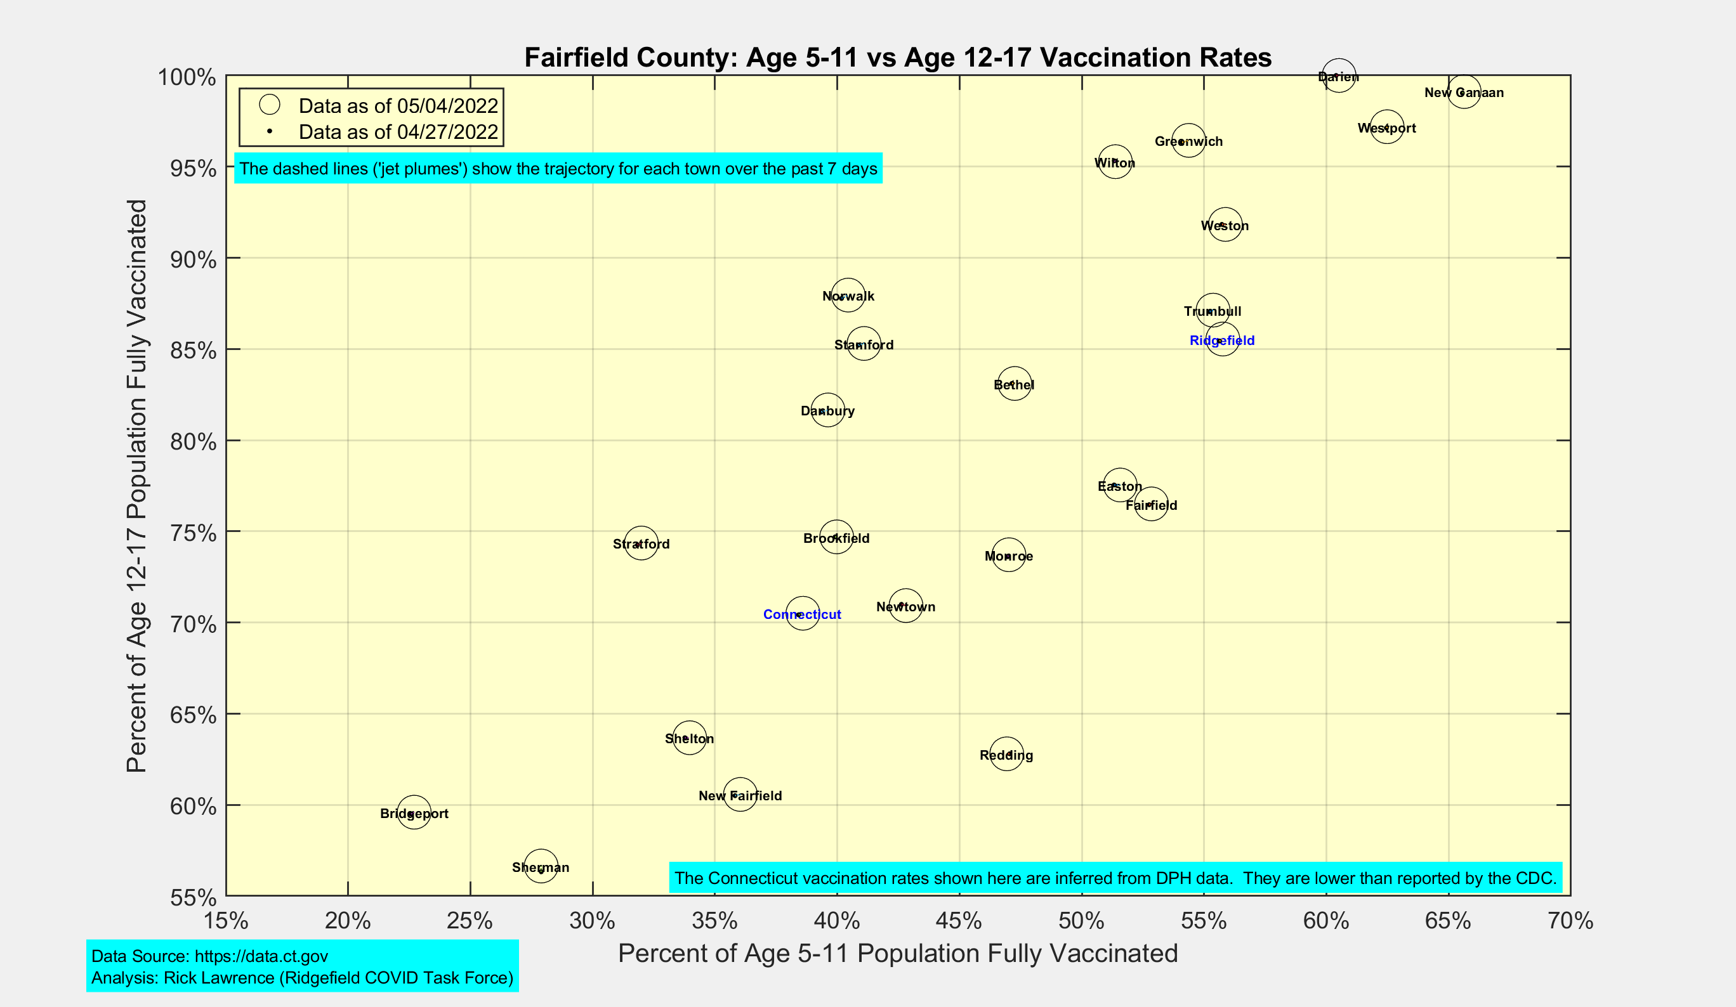
School-Age Vaccination Rates for Towns in Fairfield County

Slide 11
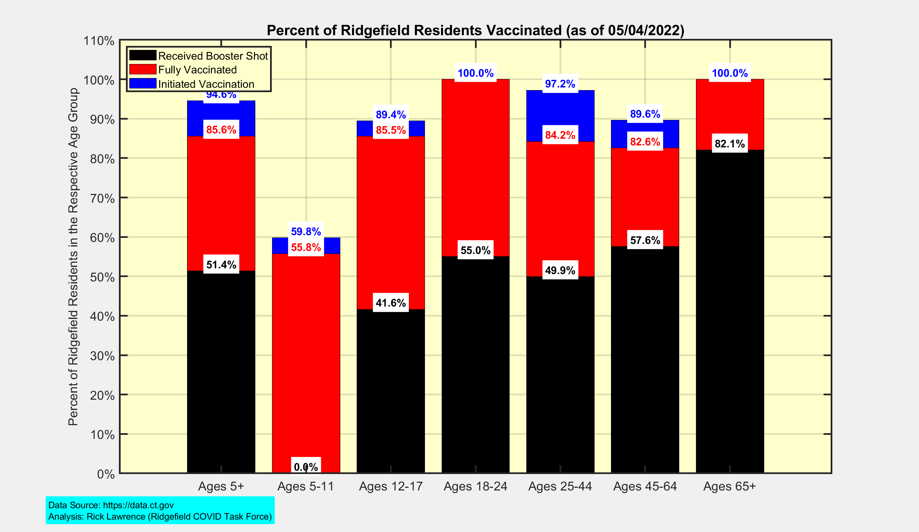
Latest Vaccination Rates for Ridgefield Residents

Slide 12
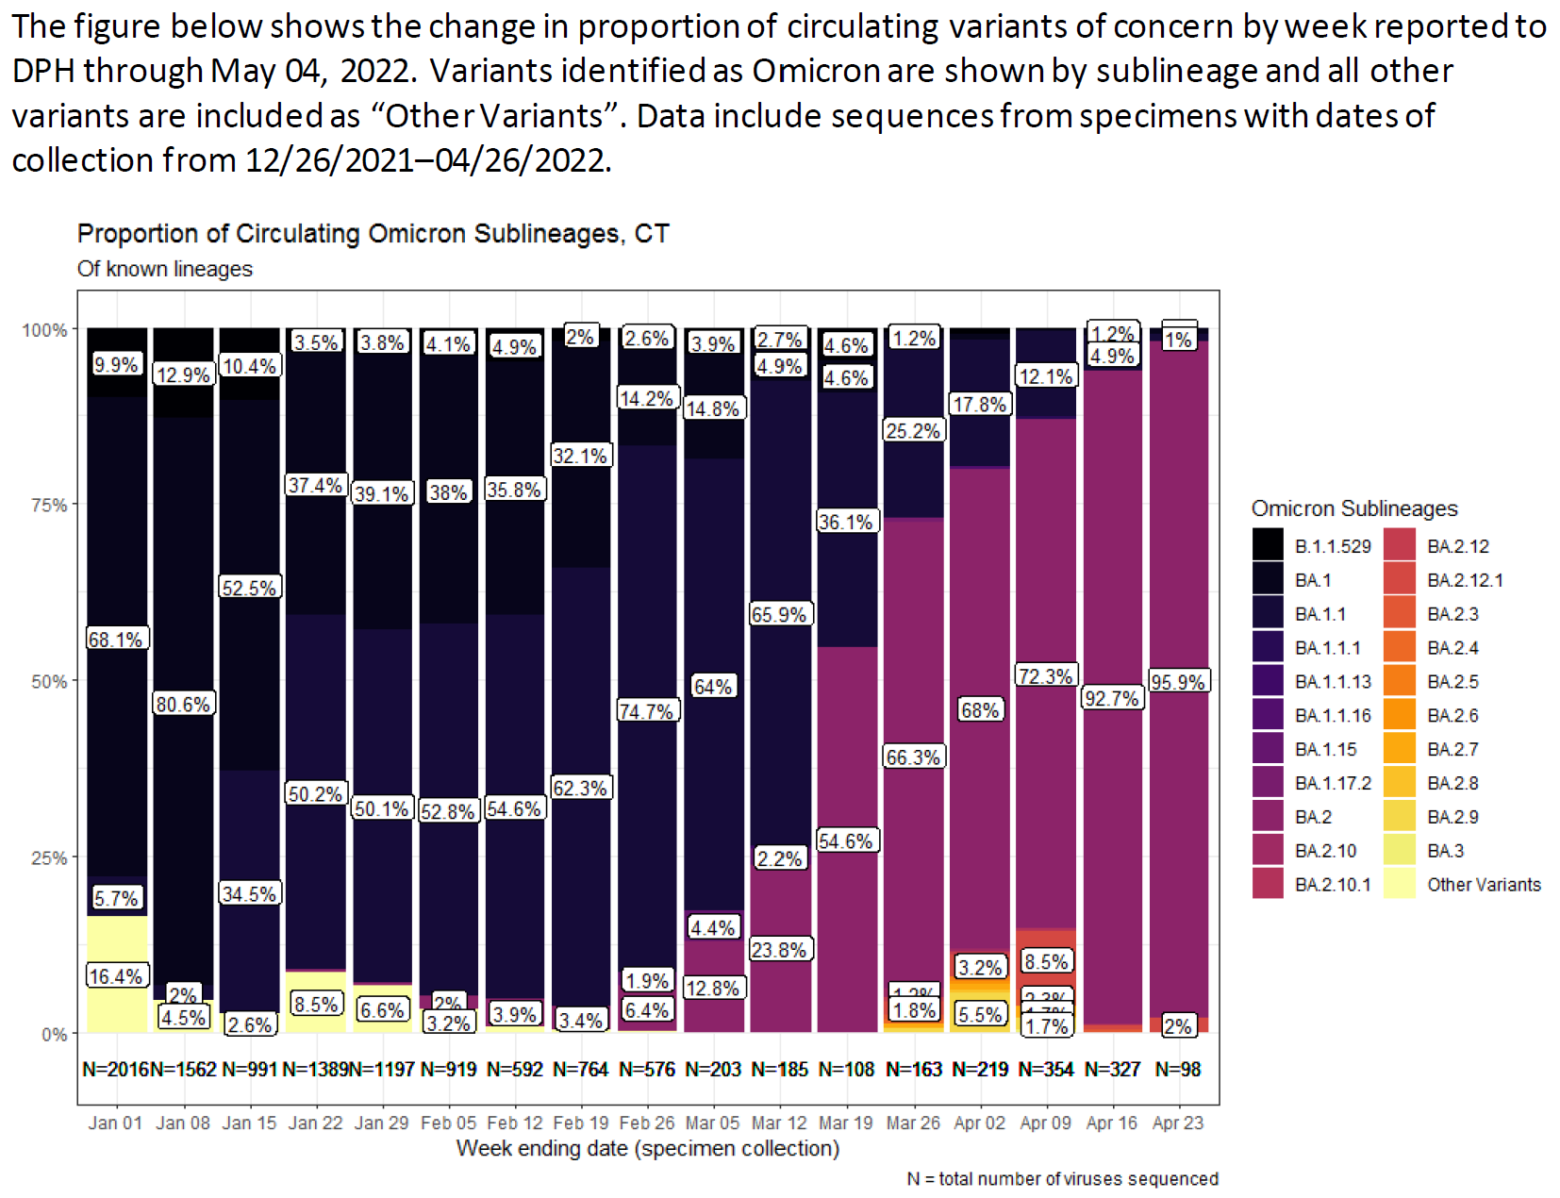
Latest Data for Connecticut shows over 95% prevalence of the BA.2 variant
Data Source: https://portal.ct.gov/-/media/Coronavirus/CTDPHCOVID19summary05052022.pdf

