Slide 1
Ridgefield COVID Summary
Ridgefield COVID-19 Task Force
Data downloaded from
https://data.ct.gov/browse?category=Health+and+Human+Services
https://covid.cdc.gov/covid-data-tracker/#vaccinations
Friday, December 23, 2022

Slide 2
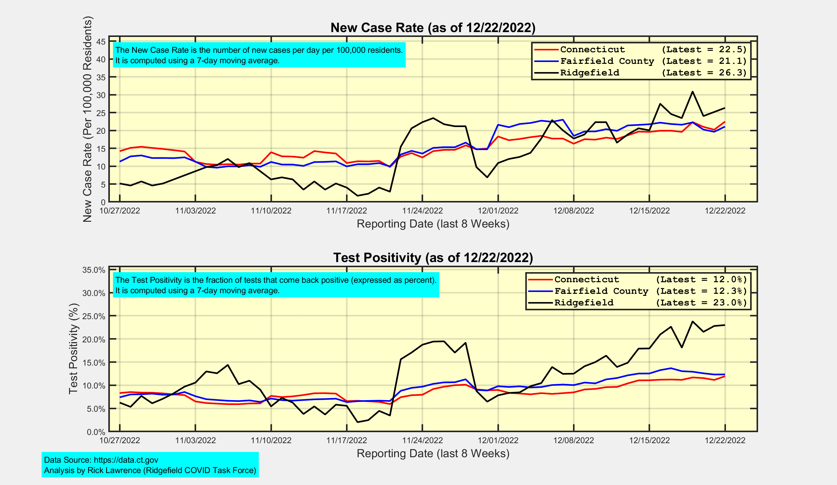
New Case Rates and Test Positivity for Connecticut, Fairfield County, and Ridgefield

Slide 3
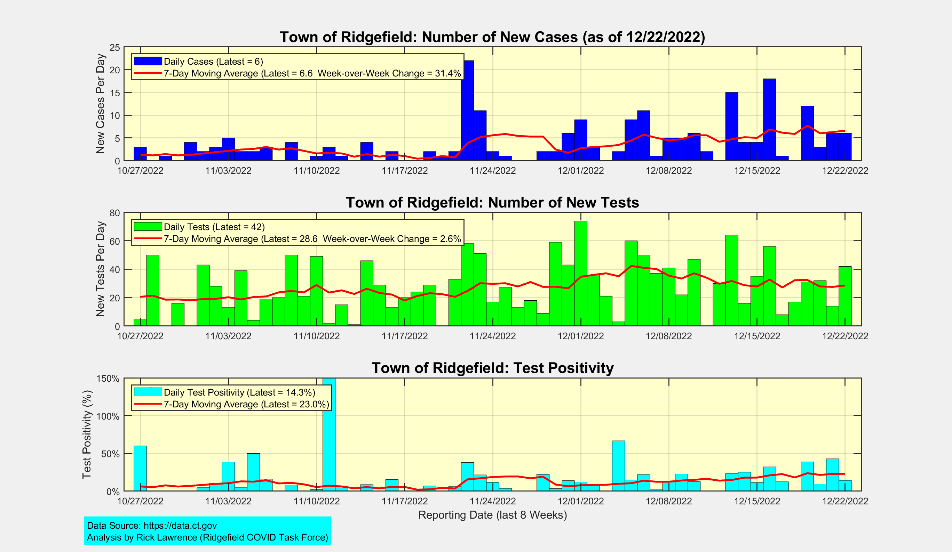
New Cases, New Tests, and Test Positivity for Ridgefield

Slide 4
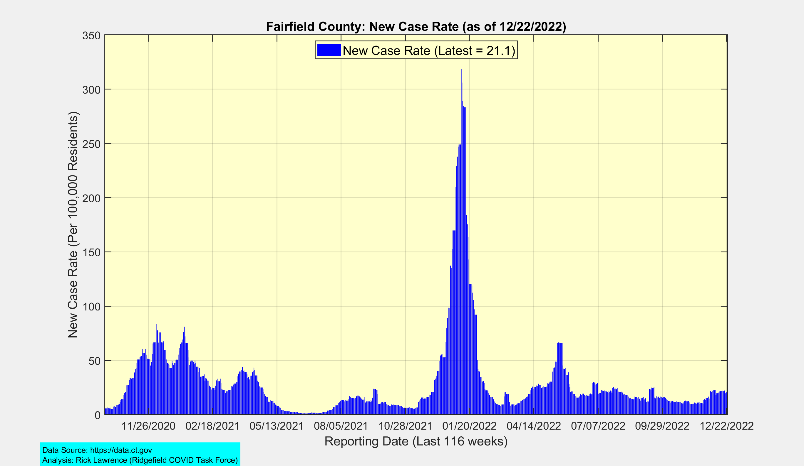
Fairfield County: New Case Rate
Omicron
BA.1
Peak
Winter
2020-21
Peak
Omicron
BA.2
Peak
Spring
2021
Peak
Delta
Peak
Cases likely under-counted due to home testing

Slide 5
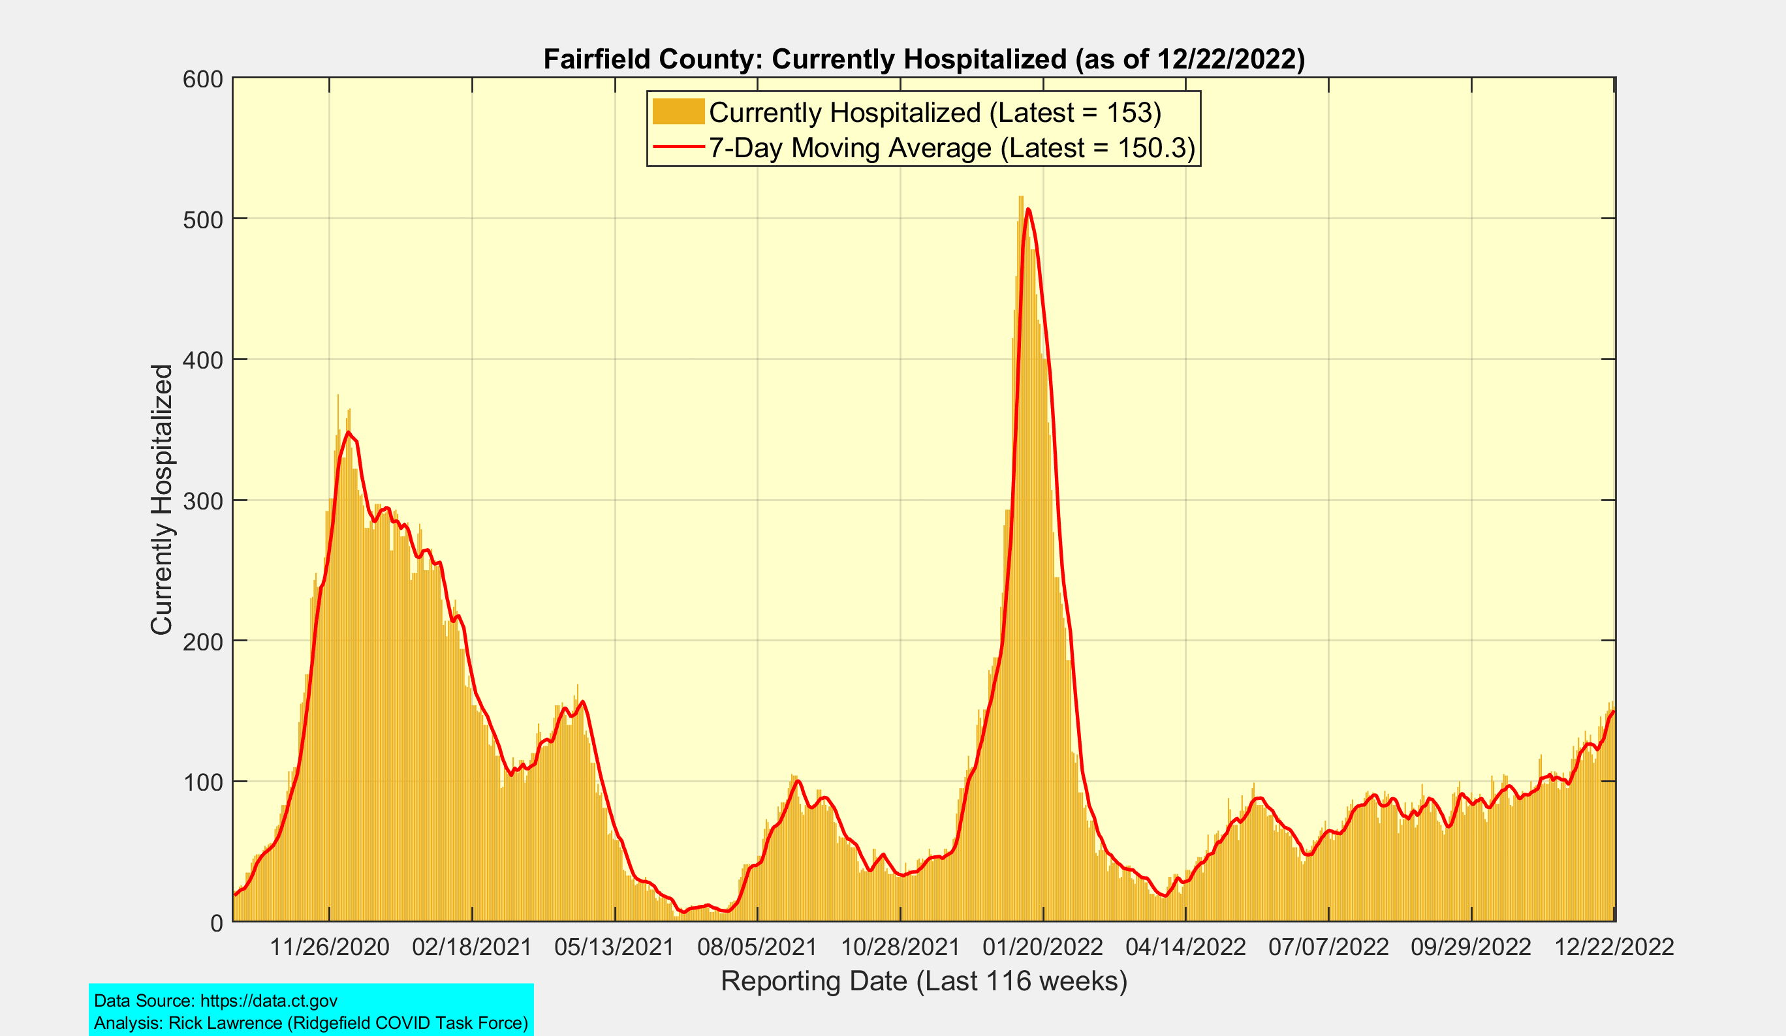
Fairfield County: Currently Hospitalized
Omicron
BA.1
Peak
Winter
2020-21
Peak
Spring
2021
Peak
Delta
Peak
Omicron
BA.2
Peak
Omicron
BA.5

Slide 6
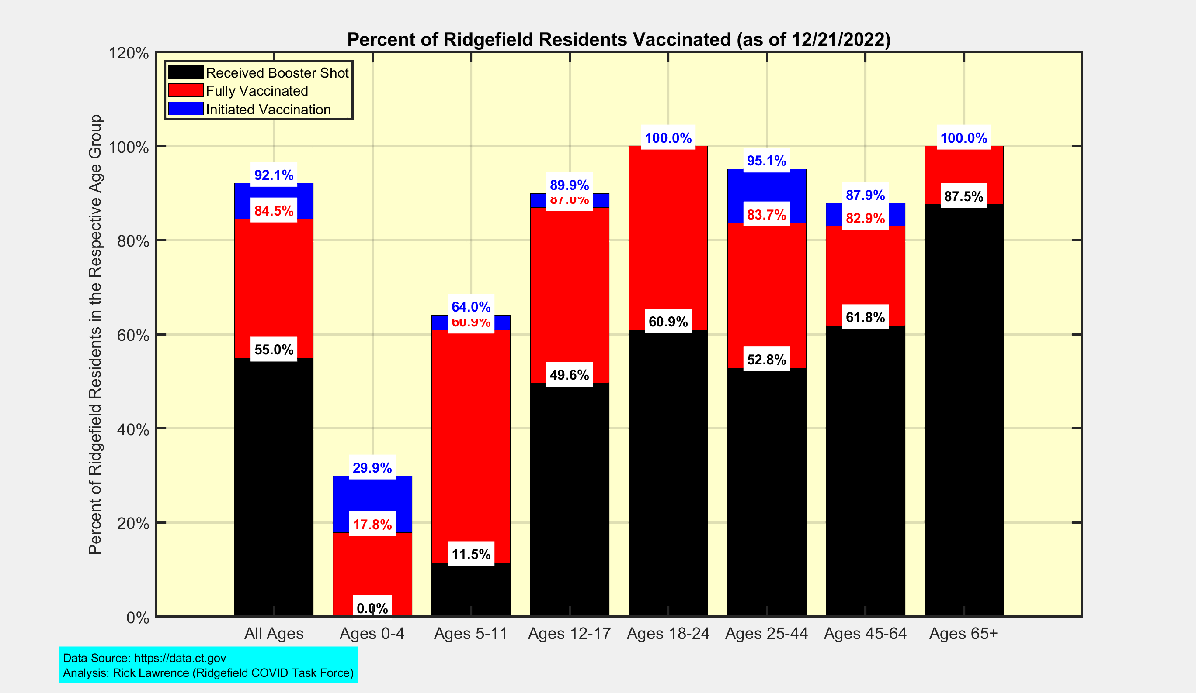
Latest Vaccination Rates for Ridgefield Residents

