Slide 1
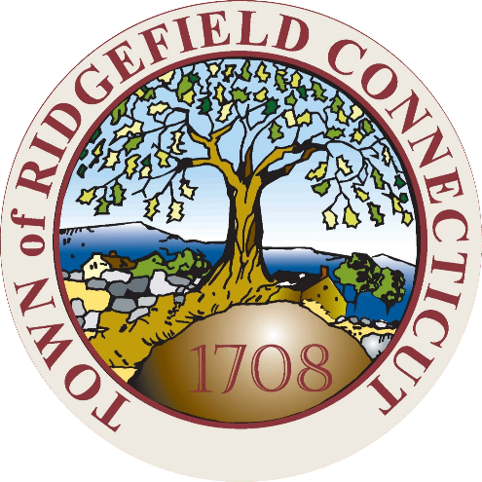
Ridgefield COVID Summary
Ridgefield COVID-19 Task Force
Data downloaded from
https://data.ct.gov/browse?category=Health+and+Human+Services
https://covid.cdc.gov/covid-data-tracker/#vaccinations
Thursday, 11/18/2021

Slide 2
Ridgefield Summary

Slide 3
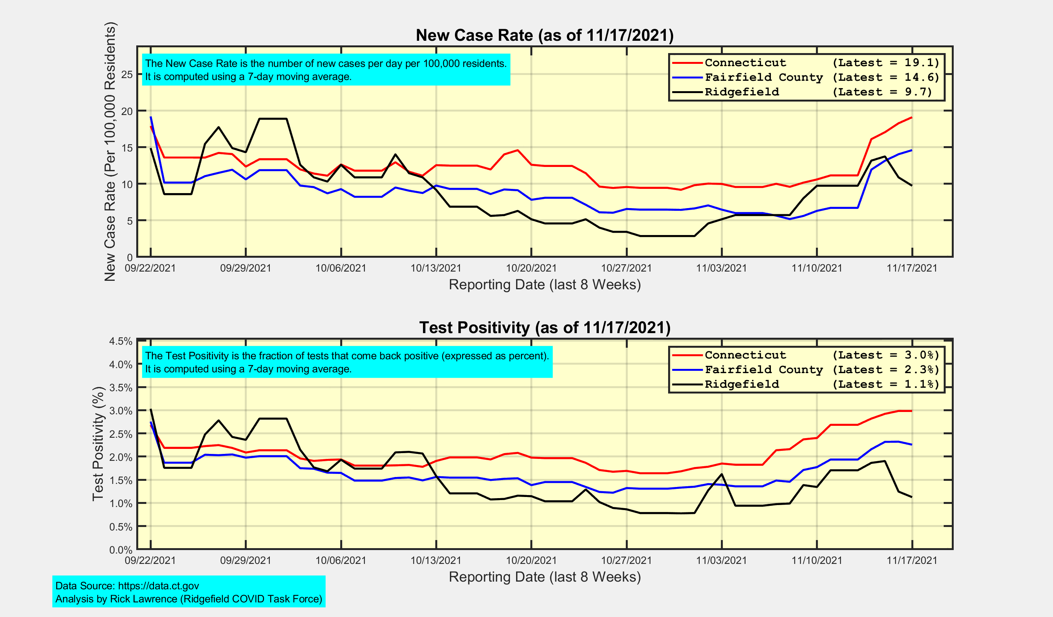
New Case Rates and Test Positivity for Connecticut, Fairfield County, and Ridgefield

Slide 4
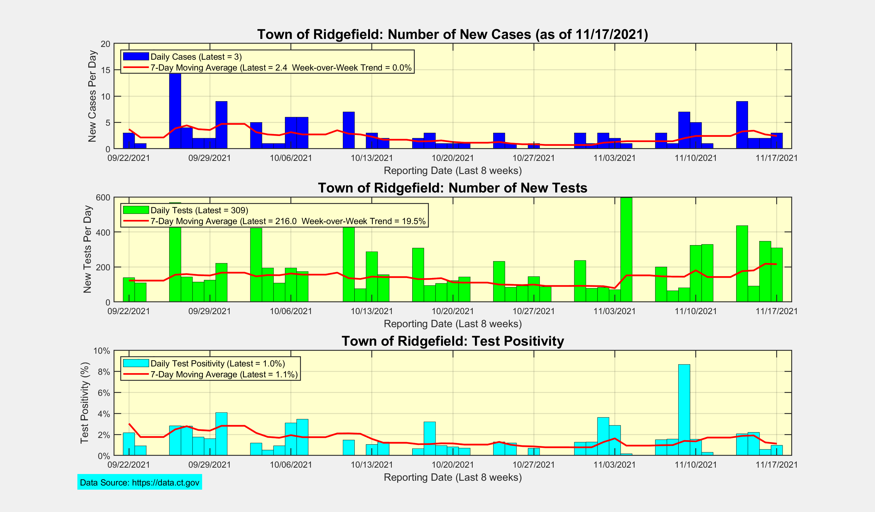
New Cases, New Tests, and Test Positivity for Ridgefield

Slide 5
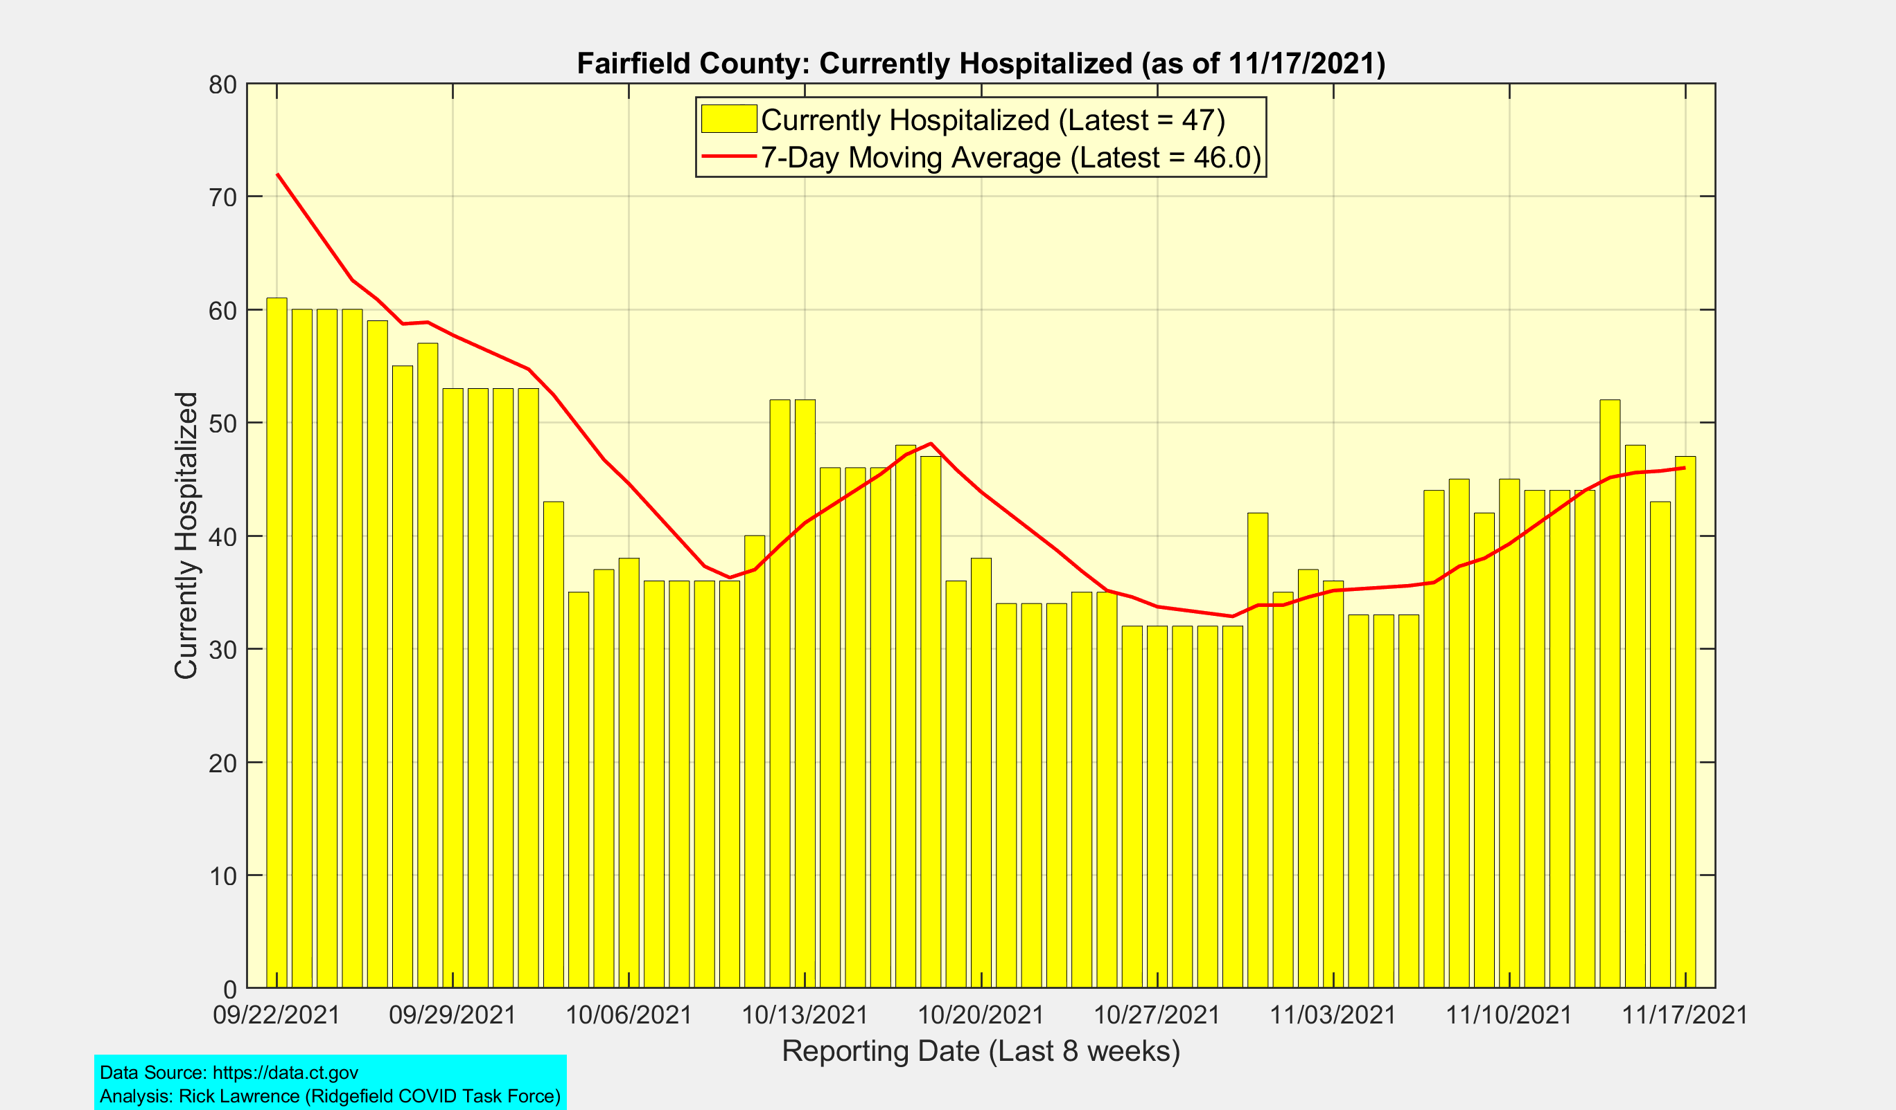
Currently Hospitalized in Fairfield County

Slide 6
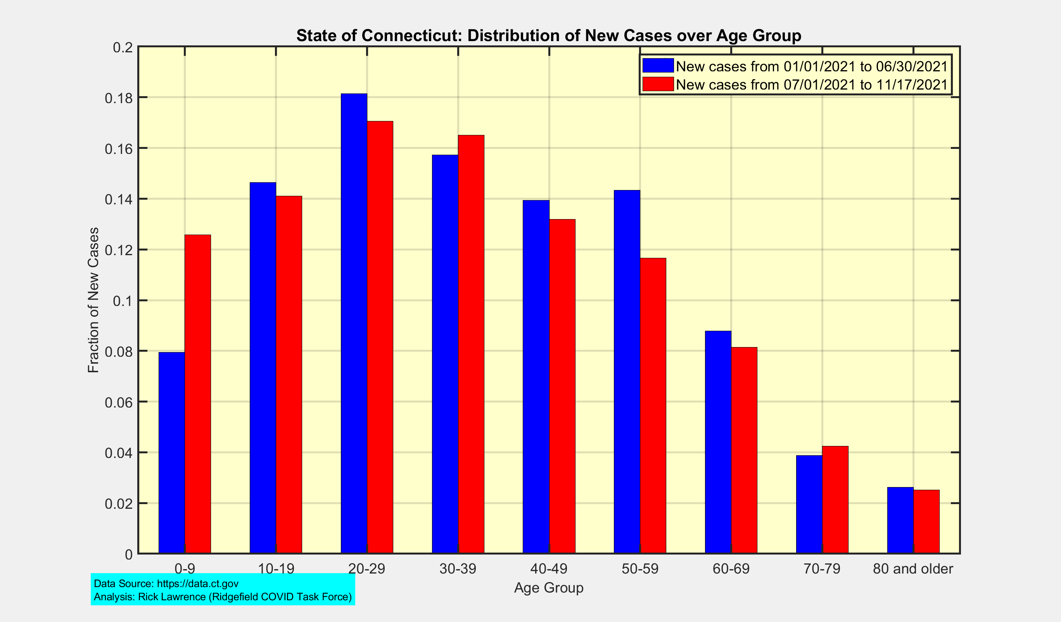
State of Connecticut: Distribution of New Cases over Age Groups

Slide 7
Connecticut and US Vaccination Summary
Since September 24, 2021, Connecticut has had the highest completed vaccination rate among all US states.

Slide 8
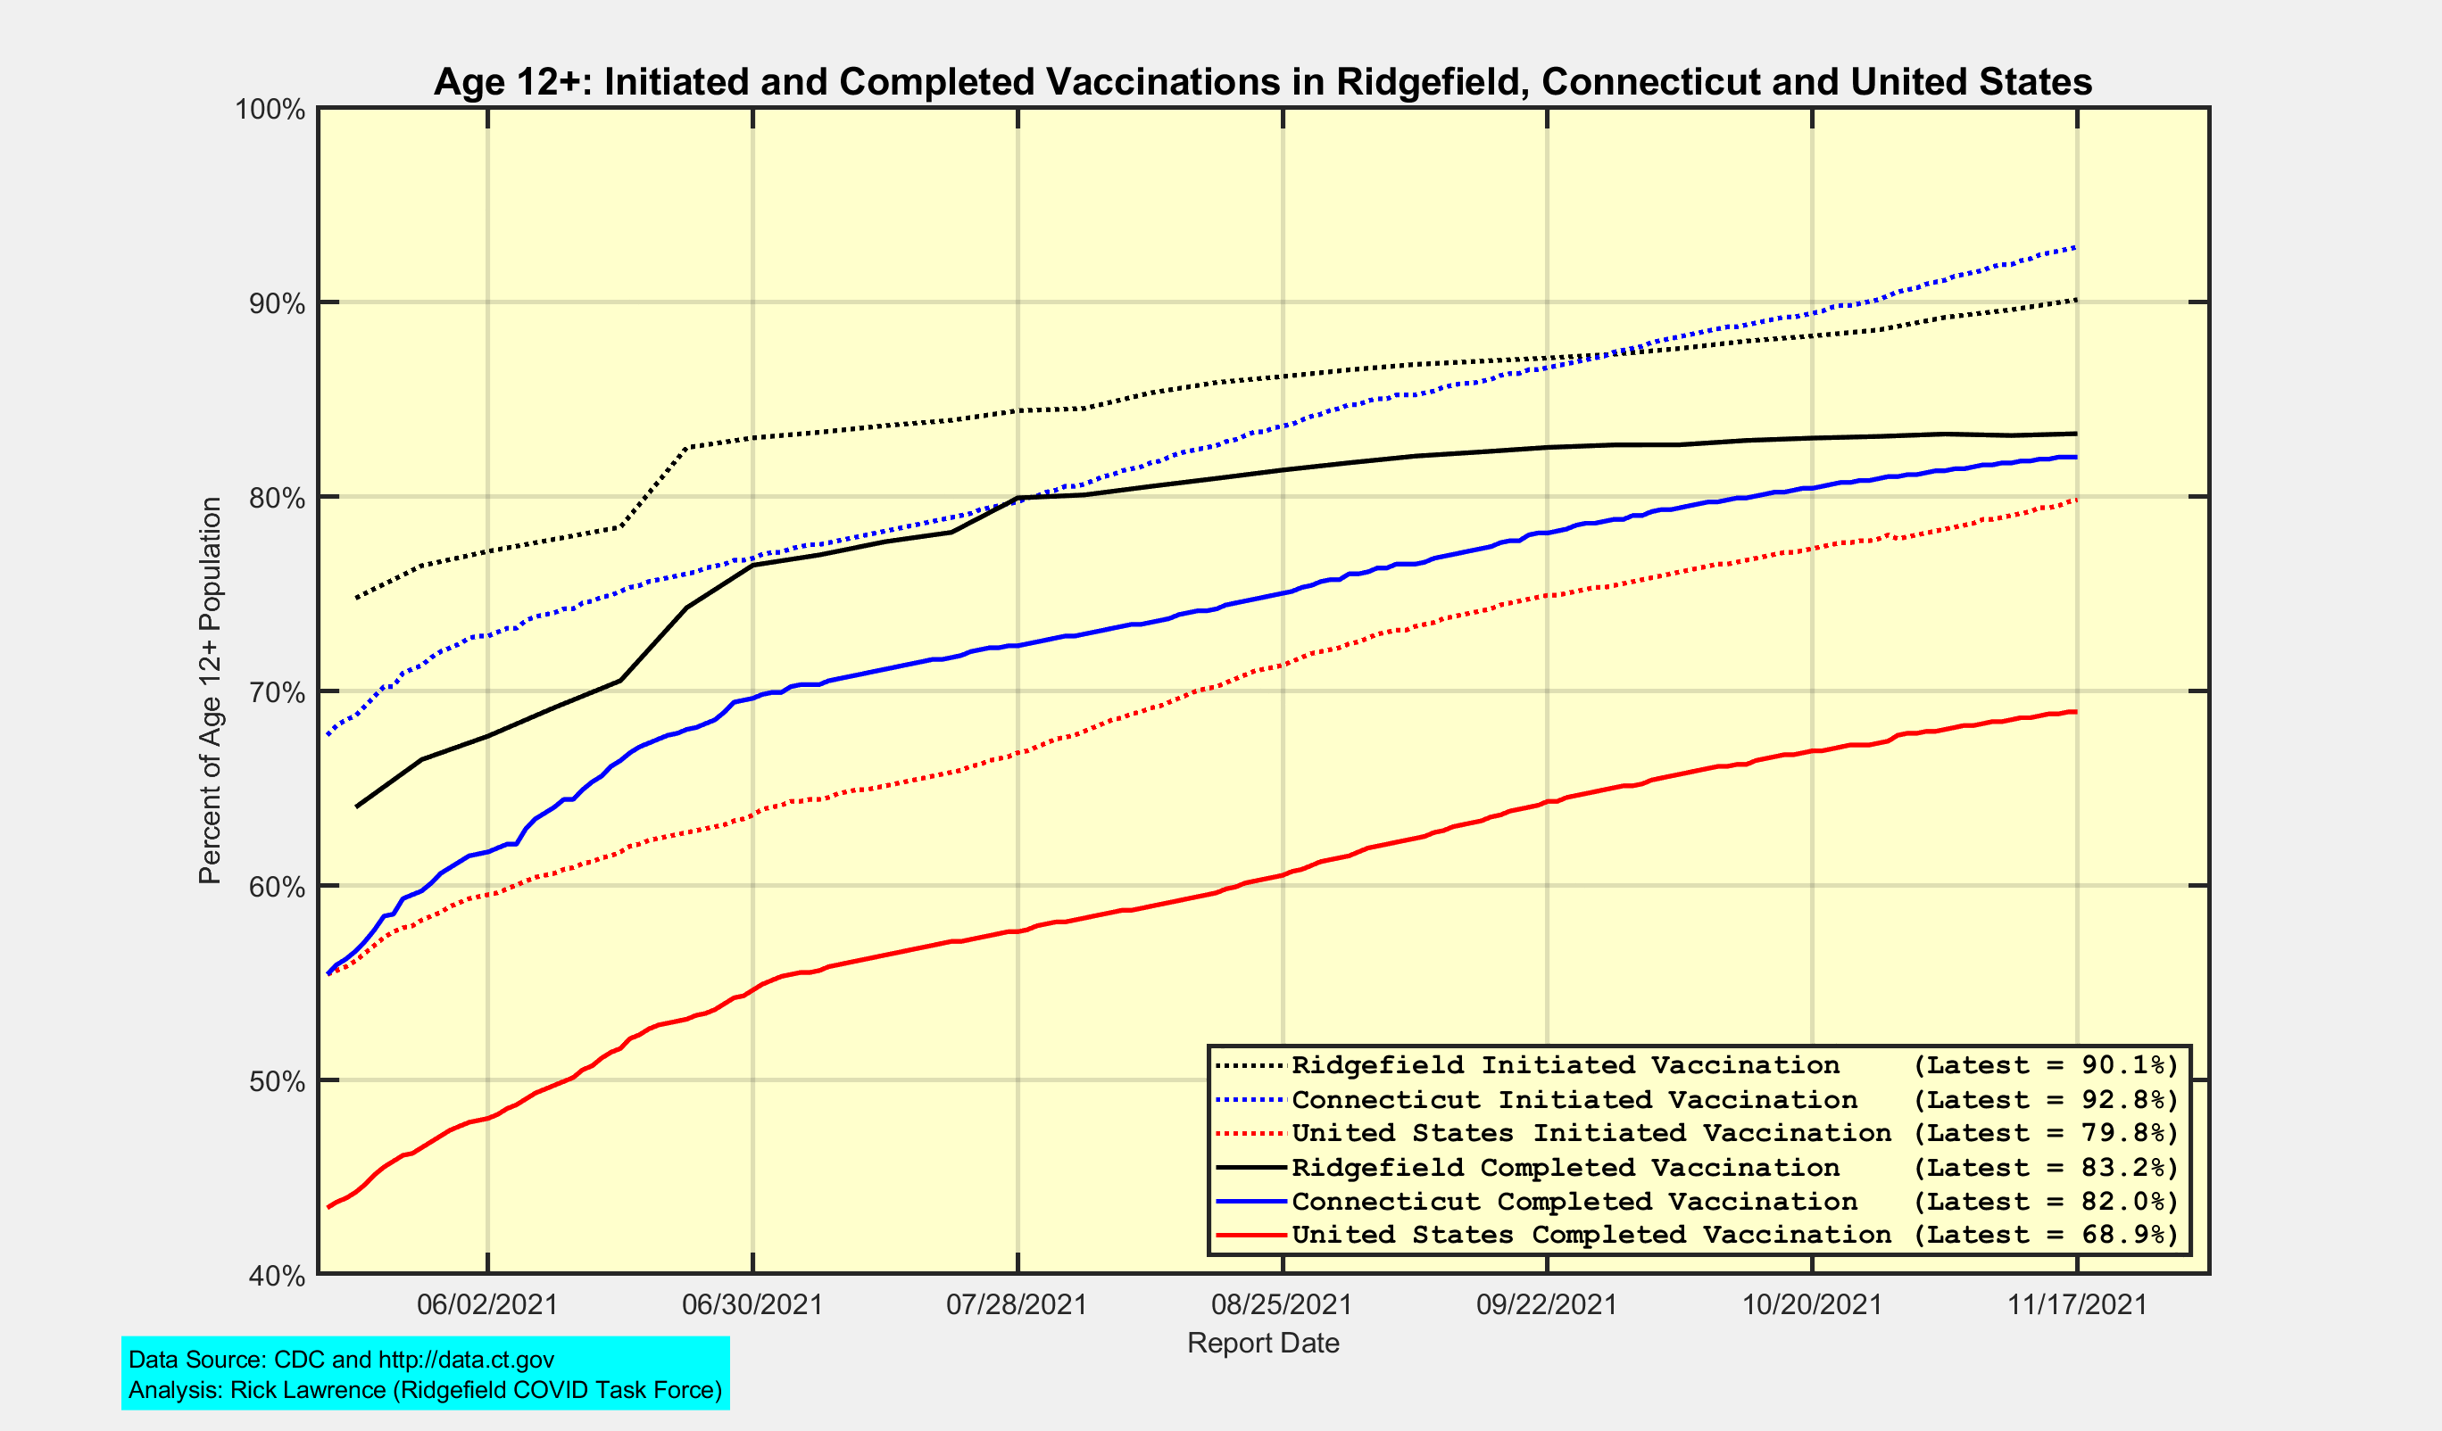
Initiated and Completed Vaccination Percents for Age 12+ (Vaccine-Eligible) Population

Slide 9
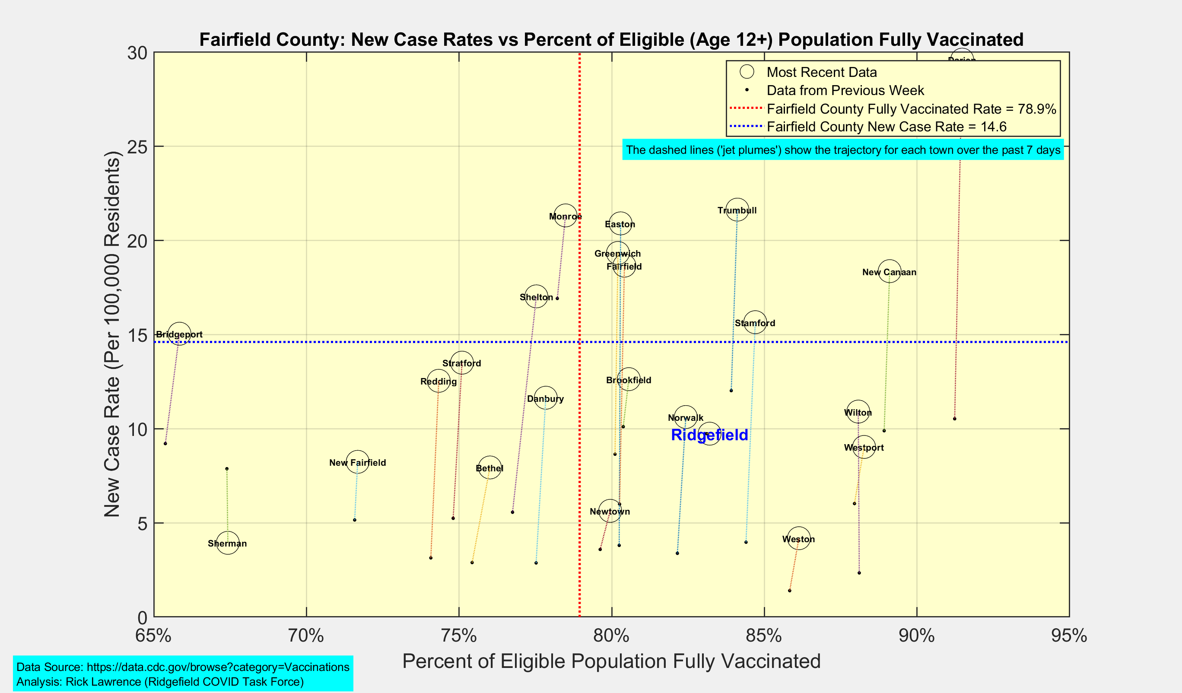
New Case Rates vs Vaccination Rates for Towns in Fairfield County

Slide 10
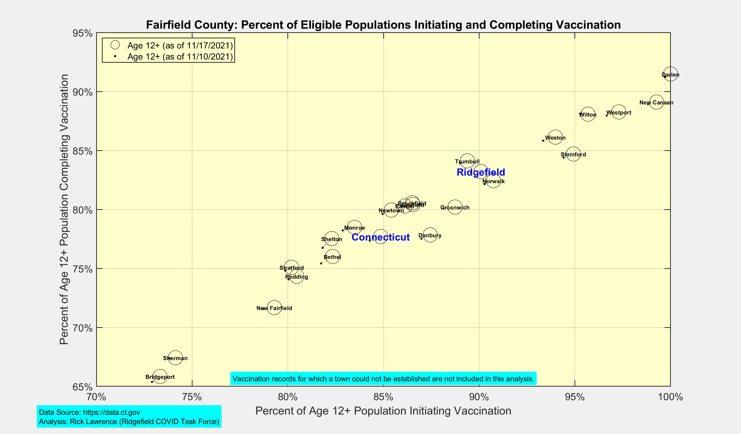
Latest Vaccination Rates for Towns in Fairfield County

Slide 11
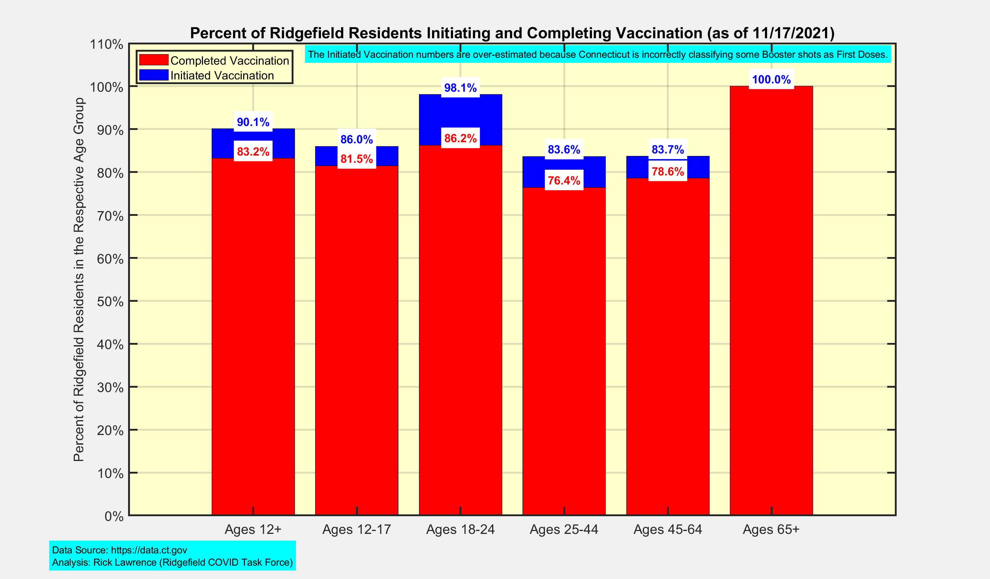
Latest Vaccination Rates for Ridgefield Residents

Slide 12
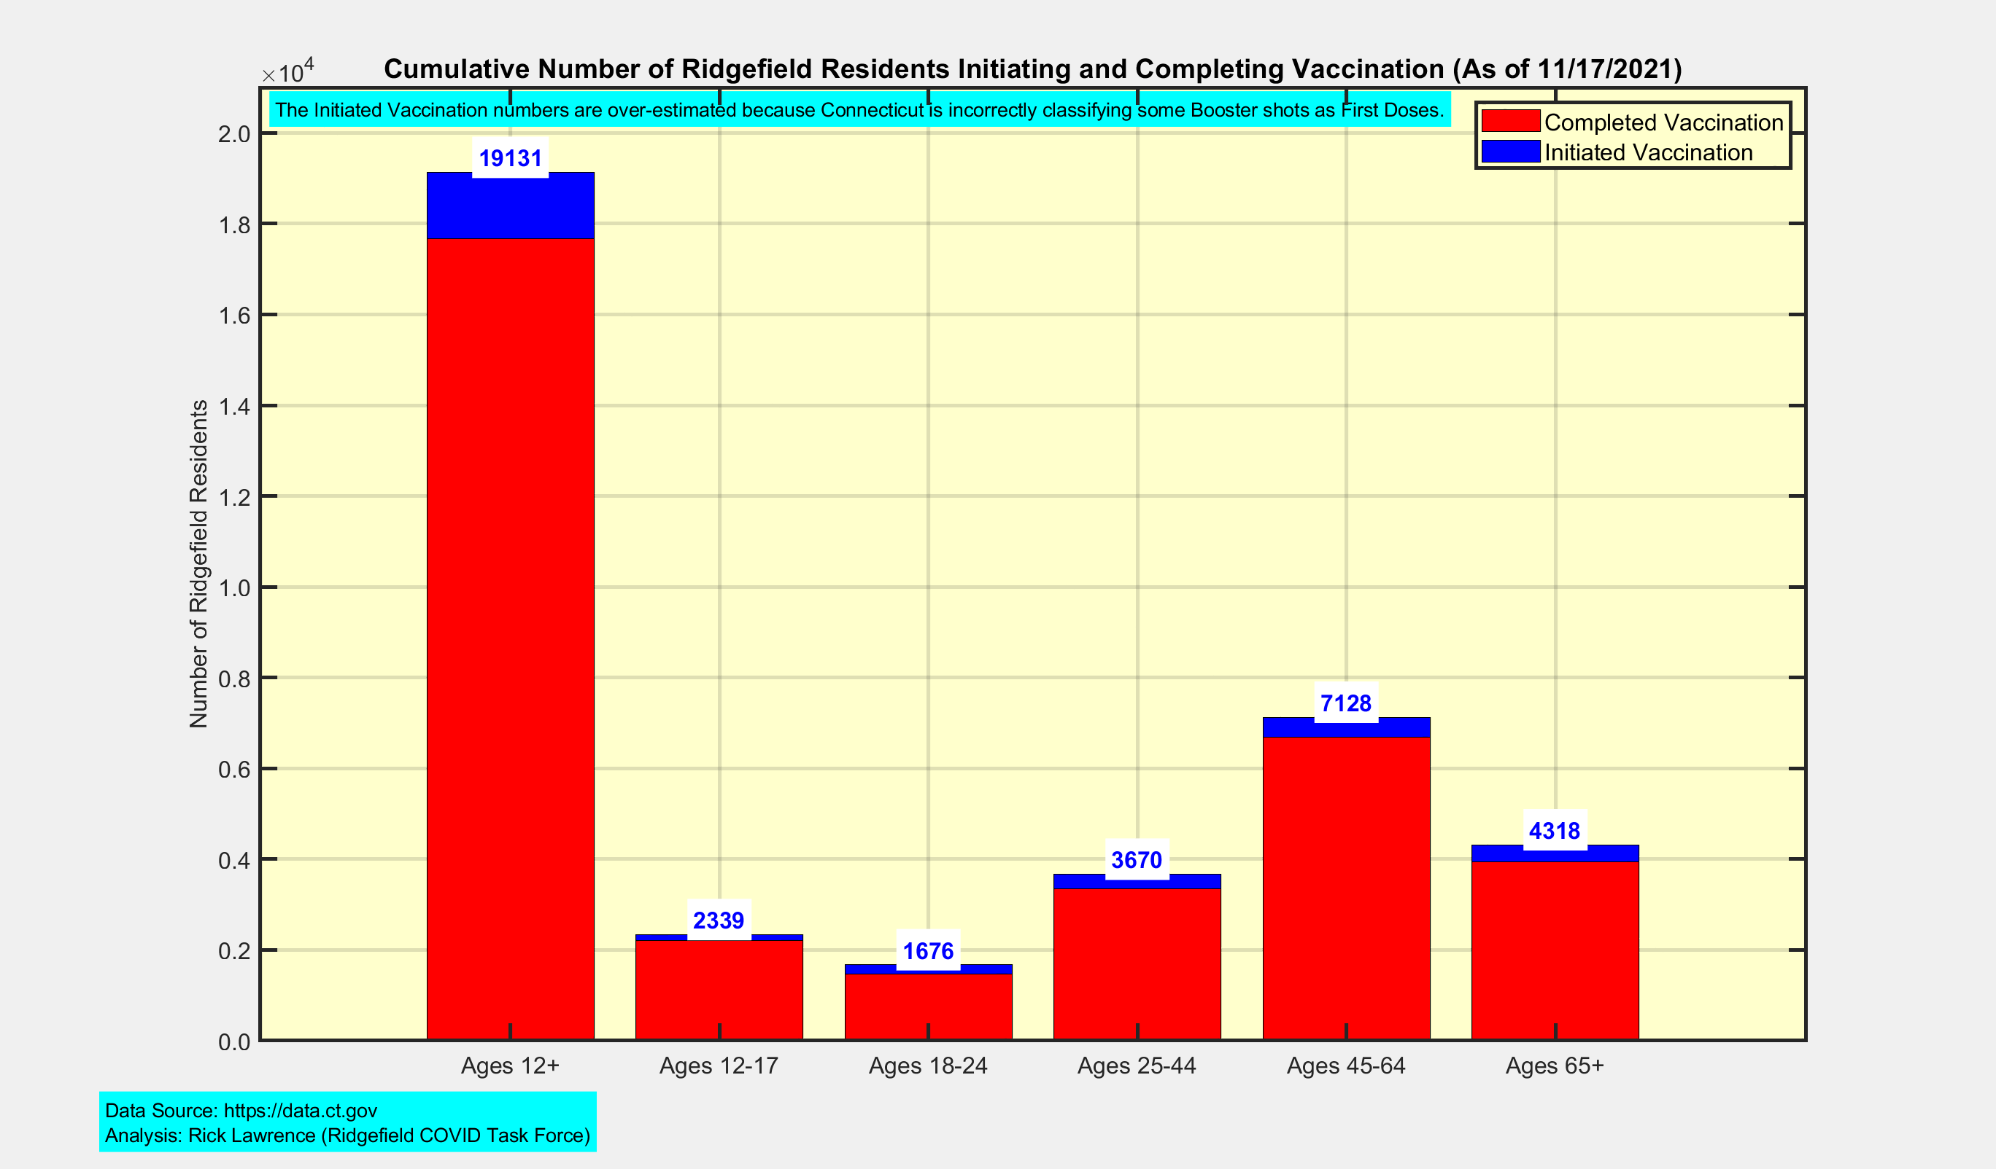
Latest Vaccination Numbers for Ridgefield Residents

